Slide 1

S/4 HANA Landscape Transformation Kick Off Session
March 10th to 12th, 2025

Slide 2
Agenda – Day 1 Monday March 10th
Time | Topic | Details | Presenter
08.00h -09.00h
09.00h – 10.00h | Welcome & Team Introduction | General, Safety, Participants Introduction, Key Messages, Workshop Targets | Pete Casazza, Adrian Espinosa, Stephan Domes
10:00h – 11:00h | SDT Kick Off Session | Introduction to SDT Migration Blueprint | Accenture
11.00h – 12.00h | Introduction Cantarell Mexico Business | Business Processes, customers, size, business model, locations, stakeholders, ... | Adrian Espinosa
12.00h – 13.00h | Lunch
13.00h – 14.00h | Introduction US Electronics Business | Business Processes, customers, size, business model, locations, stakeholders, ... | Pete Casazza
14.00h – 15.00h | Overview S/4 Program | Overview, IC, SDT, Key SAP Finance Topics, Scoping, Program Structure, .. . | Stephan Domes
15.00h – 16.00h | Project Management | Project Scope, Project Plan, Streams, Business Involvement, ... | Natarajan Thiyagarajan, Sneha Dutta, Derek Punaro, Rodolfo Ortiz Chavarin
16:00h – 17.00h | Project Management | Deliverables, RACI, SOX, ... | Sneha Dutta, Derek Punaro, Rodolfo Ortiz Chavarin

Slide 3
Agenda – Day 2 Tuesday March 11th
Time | Topic | Details | Presenter
08.00h -09.00h
09.00h – 10.00h | SDT Plan | Technical Migration Cycles, Structure, GLS, ... | Tobias Hust, Anubhab Dasgupta
10:00h – 11:00h | Overview Project Landscape/ Change Freeze | Source Systems, Target Systems, Change Freeze, UC4 Jobs, ... | Sneha Dutta, Stephan Domes, Natarajan Thiyagarajan
11.00h – 12.00h | System Build Plan | Build Plan, Provisioning, ... | Sneha Dutta, Stephan Domes, Natarajan Thiyagarajan
12.00h – 13.00h | Lunch
13.00h – 14.00h | Testing Approach | TM0 Unit Test, FUT, SIT, UAT, Sign Offs, Test Tools, … | Pallavi Banerjee
14.00h – 15.00h | Satellites US & Mexico | Global Satellites, US local Satellites, Mexico Satellites | Leonard Eynon, Stuart Boyd, Martin Vega
15.00h – 16.00h | Cut Over Approach | Structure, Approach, Approvals, Governance, Stakeholders, Plan, Decision Points, … | Sneha Dutta, Stephan Domes, Natarajan Thiyagarajan
16:00h – 17.00h | Project Management | Project Organization, Stream set-up, Planning Approach | Sneha Dutta

Slide 4
Agenda – Day 3 Wednesday March 12th
Time | Topic | Details | Presenter
08.00h -09.00h | Roles Approach | Single Role, Composite Role, Sign Off, End User Simulation, … | Gellert Kovacs
09.00h – 10.00h | Organizational Change Management | Train-the-Trainer, Tester Training, End User Training, Communication, Newsletter, … | Sneha Dutta, Derek Punaro, Rodolfo Ortiz Chavarin
10:00h – 11:00h | Communication | US Stakeholders, Mexico Stakeholders, Project Meeting Structure, … | Sneha Dutta, Derek Punaro, Rodolfo Ortiz Chavarin
11.00h – 12.00h | Risk Assessment | Identification of project risks | All
12.00h – 13.00h | Lunch
13.00h – 14.00h | Wrap-Up | Document action items & Workshop Closure | Sneha Dutta, Derek Punaro, Rodolfo Ortiz Chavarin
14.00h – 15.00h
15.00h – 16.00h
16:00h – 17.00h

Slide 5
Agenda – Day 1 Monday March 10th
Time | Topic | Details | Presenter
08.00h -09.00h
09.00h – 10.00h | Welcome & Team Introduction | General, Safety, Participants Introduction, Key Messages, Workshop Targets | Pete Casazza, Adrian Espinosa, Stephan Domes
10:00h – 11:00h | SDT Kick Off Session | Introduction to SDT Migration Blueprint | Accenture
11.00h – 12.00h | Introduction Cantarell Mexico Business | Business Processes, customers, size, business model, locations, stakeholders, ... | Adrian Espinosa
12.00h – 13.00h | Lunch
13.00h – 14.00h | Introduction US Electronics Business | Business Processes, customers, size, business model, locations, stakeholders, ... | Pete Casazza
14.00h – 15.00h | Overview S/4 Program | Overview, IC, SDT, Key SAP Finance Topics, Scoping, Program Structure, .. . | Stephan Domes, Natarajan Thiyagarajan
15.00h – 16.00h | Project Management | Project Plan, Streams, Business Involvement, ... | Natarajan Thiyagarajan, Sneha Dutta, Derek Punaro, Rodolfo Ortiz Chavarin/ Leticia Mellado
16:00h – 17.00h | Project Management | Deliverables, RACI, SOX, ... | Sneha Dutta, Derek Punaro, Rodolfo Ortiz Chavarin/ Leticia Mellado

Slide 6



S/4 HANA Technology
Technology change requires landscape Transformation as opposed to Upgrade
established
2004
retires
2025 - 2027
SAP ERP Central Component (SAP ECC) runs on ‘classic’ SQL (ORACLE) database –
end-of-life 2025/ 27
ECC
SAP technology transformation required as opposed to JDE upgrade from 9.0 to 9.2 being ‘just’ a technology migration / upgrade
established
2015
retires earliest
2040
SAP Business Suite for SAP HANA (SAP S4HANA or short S4) architecture shift to ‘in-memory’ HANA database, User Interface mobile centric (FIORI)
Impact
Much higher application and integrated systems performance (in-build Analytics, e.g. eChannel benefits)
Significant Data Model changes, code and data conversion projects
In-memory TB cost factors more expensive, need to reduce data volumes (Archiving: 2y data retention)
In-Memory Database
SAP is renovating most of the peripheral suite applications in parallel
Linde must address ~40 systems as part of the landscape transformation
Some system migrations, some replacements
SAP Application Suite
Business
Albeit multiple workshops with SAP and Linde experts, insignificant benefits for gases business identified
Hence technical transformation program required (a.k.a. Brownfield)
Notes:
S/4 HANA is considered a different product to ECC, it is not an upgrade release to ECC​!
HANA = Hasso’s New Architecture or High-Performance Analytic Appliance

Slide 7
S/4 Journey: History and outlook …
S/4 Strategy Paper prepared
supported by Accenture – conclusion:
“limited value … wait & educate”
Impress S/4 System
Technical Transformation PoC
Korea Go Live in Jan. 2023
RSE Go Live in Jan. 2024
SAP announced extended EoL
until 2027/30
Kick off S/4 Project for Korea
RUI Go Live in Sep. 2024
RGC Go Live in Feb. 2025
1st Program Investment Approval
2nd Program Investment Approval
3rd Program Investment Approval
US & Mex Kick Off 2025
SAP ERP Landscape technically transformed
to S4HANA
Merger
2018
2019
2020
2021
2022
2023
2024
2025
2026
2027
2030
SAP Landscape Transformation to S/4 incl. SAP Satellites
ERP strategy:
JDE in Americas
SAP in APAC & EMEA
Kingman US & IN migration from JDE to SAP
TH migration from JDE to SAP
CN migration from JDE to SAP

Slide 8
S/4 HANA Technical Transformation Program Main Tasks
S/4 HANA Program Roadmap Management
Planning
Alignment etc.
S/4 HANA Platform Management
Platform Architecture
Hosting etc.
S/4 HANA Program Contracting
Program Master Agreement , SNP License
Archiving etc.
S/4 HANA Program Financial Management
Investment Committee
Program Controlling etc.
S/4 HANA Program Governance
Organization
RASCI etc.
S/4 HANA Program Management
Stakeholder Management (Program SteerCo, Operating Segment Jour Fixes etc.)
Main contact to regional projects, Risk Management etc.
S/4 HANA Program Organizational Change Management
Communication
Knowledge Base etc.

Slide 9

S/4 HANA Technical Transformation Program Roadmap – On Track
BOCT EoL
------------ ECC EoL-------------
2022
2023
2024
2025
2026
2027
2028
2029
IC1
01.01.23
IC2
IC3
IC4
IC5
RSE
Mobilization
ASEAN & South Asia
P8E SDT
S4
2021
S4
2021
22.01.24
Program includes S/4HANA Projects and Satellites
Technical Transformation
Learnings from former projects
Balance Corp resources between different projects
BOCT End of Life timeline
CAPEX approval in IC3
Planning of 2025 activities
P8E
RUI
Mobilization
RUI
PRD SDT
01.07.22
S4
2021
01.09.23
8.09.24
PRD
RGC
Mobilization
Greater China (RGC)
P6E SDT
BOCT
01.03.23
S4
2021
19.02.24
16.02.25
01.04.23
P6E
RAF
01.08.23
Mobilization
RAF
P9E SDT
S4 2023
01.08.24
11.08.25
01.06.23
P9E
US/Mx
01.05.24
Mobilization
US & Mexico
P2E SDT
S4 2023
01.03.25
09.03.26
01.06.24
P2E
01.02.26
REN
Readsoft, SAP FSM, TeleQuery etc.
Impress (REN)
P01 SDT
P01
Mobilization
21.02.27
01.03.25
S4 2023
RSP
05.11.24
PEA
Mobilization
LT (RSP)
PEA SDT
Rev Rec
S4 2023
01.09.26
19.09.27
01.10.25
REW & REE
REW/REE GPA
01.02.26
Mobilization
InTouch (REW/REE)
GPA SDT
01.04.23
Technical Clean-Up
eWM, FI CoA etc.
01.04.27
14.05.28
Rev Rec
S4 2025
Satellites
GTS
SRM / SAPHRON / PI/PO / Solman / GRC-GPU
APO Replacement
PI/PO 2025
Pre-projects
Archiving projects
Mobilization
S4 projects
Satellite Applications
S4 DEV box; access to regions for verifications
Today

Slide 10
S/4 HANA Technical Transformation Program Program Organization
S/4 HANA Program SteerCo
Denny Brown
Leon Xu, Danny Perri, Dulce Borjas*
Adrian Espinosa, P. Casazza, Michael Kurtz,
Goran Cederwall, Nat T., K. Conrad etc.
Program Controlling
Katharina Conrad
APAC IT Jour Fix
EMEA IT Jour Fix
Americas IT Jour Fix
Jason O’Brien,
Michael Kurtz*,
Goran Cederwall
Project Level
Danny Perri,
Michael Kurtz*,
Goran Cederwall
Dulce Borjas, Adrian Espinosa, P. Casazza, Michael Kurtz*, Goran Cederwall, Nat T., K. Conrad
APAC
Program Manager
EMEA
Program Manager
Americas
Program Manager
Global
Program Manager
Leon Xu
Husein Hassen
n/a
Stephan Domes
RSE
Deployment Manager
RUI
Deployment Manager
REW/REE
Deployment Manager
US & Mex
Deployment Manager
Platform Solution
Design
SDT
Sujoy Sen
Neil Kitchen
tbd
Derek Punaro,
Leticia Mellado
Tobias Hust
Tobias Hust
Infrastructure
Delivery Integration
RGC
Deployment Manager
REN
Deployment Manager
Thomas Gerulat
Nat Thiyagarajan
RAF
Deployment Manager
PMO
Dewey Chen
Husein Hassen
tbd
Sneha Dutta
Jana Leibiger
Simona Roth
RSP
Deployment Manager
Damian Noll
*Invited on request
Regional IT
Corporate Function

Slide 11
Agenda – Day 1 Monday March 10th
Time | Topic | Details | Presenter
08.00h -09.00h
09.00h – 10.00h | Welcome & Team Introduction | General, Safety, Participants Introduction, Key Messages, Workshop Targets | Pete Casazza, Adrian Espinosa, Stephan Domes
10:00h – 11:00h | SDT Kick Off Session | Introduction to SDT Migration Blueprint | Accenture
11.00h – 12.00h | Introduction Cantarell Mexico Business | Business Processes, customers, size, business model, locations, stakeholders, ... | Adrian Espinosa
12.00h – 13.00h | Lunch
13.00h – 14.00h | Introduction US Electronics Business | Business Processes, customers, size, business model, locations, stakeholders, ... | Pete Casazza
14.00h – 15.00h | Overview S/4 Program | Overview, IC, SDT, Key SAP Finance Topics, Scoping, Program Structure, .. . | Stephan Domes, Natarajan Thiyagarajan
15.00h – 16.00h | Project Management | Project Scope, Project Plan, Streams, Business Involvement, ... | Natarajan Thiyagarajan, Sneha Dutta, Derek Punaro, Rodolfo Ortiz Chavarin/ Leticia Mellado
16:00h – 17.00h | Project Management | Deliverables, RACI, SOX, ... | Sneha Dutta, Derek Punaro, Rodolfo Ortiz Chavarin/ Leticia Mellado

Slide 12
Project S/4 HANA US & Mexico – Scoping Overview
Overall approach is to keep the functionality as is, i.e., all functionality which is currently in operations as on Dec 2024 will be delivered in S/4HANA, unless it is mandated by SAP as change in the Simplification or Compatibility list.
Only active legal entities (company codes) will be migrated to S/4HANA
User roles will be reorganized to factor S/4HANA role concepts and new transactions.
All existing Satellites (including SRM and GTS) and interfaces will continue.
In FICO, following are the mandatory changes –
New GL, new Asset Accounting, Material Ledger
Customer/Vendor Integration (CVI)
Only mandatory Fiori apps will be included (replacement of an existing transaction code, optional ones will be enabled but not promoted).
Data Archiving is a pre-requisites (2 years plus current year data will reside in SAP & 10 years retained in IXOS Archive)
Regional BW will be replaced by Global SAP BW (GPR)
All Data extractors (e.g. Informatica) and impacted reports will be adjusted to new S/4HANA structures.
Own separate US & Mexico Development environment(s) decision taken
Hosting landscape location is T-Systems (Frankfurt, Germany)

Slide 13
Project S/4 HANA US & Mexico – Scoping Functional decisions signed off by US and MX
Functionality | Comments | Country in scope
1. Universal Journal (new GL) (integrated FI & CO) | Consolidated single table across FI & CO with real-time reconciliation of Financial Accounting with Controlling & Fixed Assets | US/MX
2. Business Partner | Integrated Business Partner master data as parental node for customer, vendor, and other partners (only technical activation, no streamlining of customers and vendors as part of project) | US/MX
3. Material Ledger | Technical activation with S/4HANA go live, for potential future use delivering more detailed material costing | US/MX
4. Financial Supply Chain Management | Mandatory migration from ECC Credit Management | US/MX
5. Parallel Ledgers | Leverage Universal Journal (new GL) and activate parallel ledgers for group/local tax / local reporting | US/MX
6. Document Split | Splitting Balance Sheet accounts by lines of business (not seen as relevant for both US and MX given the singular business model) | Not required for both
7. Account Based Customer Profitability (COPA) | Technical activation to allow real-time reconciled Customer Profitability with General Ledger. Existing costing based COPA will continue in parallel, to allow business multiple months before switching to account based COPA | US only

Slide 14
S/4 HANA Technical Transformation Program Project Work Packages
Project Work Packages to be adjusted to local project:
Mobilization
Archiving
Financial and contractual activities
Project Preparation (team onboarding, KT-sessions, planning, Project Governance)
S/4 HANA Activities (Simplification & Compatibility, Interfaces, Reporting, Testing & Auto, Roles, Add-Ons)
Shell Conversion
Roles
Single Role Design & Build
Composite Role Design & Build
End User Simulation
SDT Migration
Migration Blueprint
Technical Migration 0, 1 and 2
Go Live Simulation
Testing
Functional Unit Test
TM0 Unit Testing
System Integration Test
User Acceptance Test
Automation Test

Slide 15
Project S/4 HANA US & Mexico Project Plan
2024
2025
2026
Dec
Jan
Feb
Mar
April
May
June
July
Aug
Sep
Oct
Nov
Dec
Jan
Feb
March
April
Project Start
5 weeks
14 weeks
27 weeks
6 weeks
Go Live
6 weeks
Mobilization
Analyze &
Design
Develop
Testing
Cut Over
Hypercare
Project
Archiving
Archiving execution
Soft Freeze
Change Freeze
Archiving completed
Functional Unit Testing
TM0 Unit Test
Go Live
Development
&
Functional
Build & Config & Unit Testing
Cut Over Prep
09.03.26
6 weeks
Interface Planning
3 weeks (2. – 20.02.)
Hypercare
Create Test Strategy & Plan
Dress Reh
Kick Off
Test Automation Build
8 weeks (18.8. -10.10.)
9 weeks (24.11. – 23.1.)
Project Management (Financial, Gov)
SIT
UAT
xyz
(Add-On)
Add-Ons
Functional Data Val.
Functional Data Validation
5 weeks (3.3. – 04.04.)
8 weeks (23.06. – 15.08.)
6 weeks (13.10. – 21.11.)
2 weeks
SDT
SDT MBP
11 weeks (07.04. – 20.06.)
TM1
TM2
GL Sim
Onboarding & Plan
TM0
8 weeks
6 weeks
6 weeks
System
build
TM0, SRC1
TM2, SRC1
GLS (T8A)
12 weeks
15 weeks
1 week
TM1 (T8A), SRC2
Productive P2A
DR
Analysis
Dashboard analysis & configure
Reporting
BW Queries & S4 HANA Gap analysis & build
Dev BW to GDR
Local extractor analysis & build
Related Projects
xyz
SAP
Authorization
Single Role Design
Single Role Build
Single Role Test
Mapping EU
Job/Composite Role Design
Job/Comp. Role Build
Comp. Role Test
EU Simulation
Development
Dual Maintenance
Change Mgt.
Approach
Build Training Material
Train-the-Trainer
Prep
EU Training
Vacation period
Regional
Corporate

Slide 16
Project S/4 HANA US & Mexico Project Plan
2024
2025
2026
Dec
Jan
Feb
Mar
April
May
June
July
Aug
Sep
Oct
Nov
Dec
Jan
Feb
March
April
Project Start
5 weeks
14 weeks
27 weeks
6 weeks
Go Live
6 weeks
Mobilization
Analyze &
Design
Develop
Testing
Cut Over
Hypercare
Project
Archiving
Archiving execution
Soft Freeze
Change Freeze
Archiving completed
Run COW activities
Trail Balance, Testing
Sign Off Cut Over
Functional Unit Testing
TM0 Unit Test
Go Live
Development
&
Functional
Build & Config & Unit Testing
Prepare Test Cases
Execute Test Cases
Defect retesting
Sign Off UAT
Cut Over Prep
09.03.26
6 weeks
Interface Planning
3 weeks (2. – 20.02.)
Hypercare
Create Test Strategy & Plan
Dress Reh
Kick Off
Test Automation Build
8 weeks (18.8. -10.10.)
9 weeks (24.11. – 23.1.)
Project Management (Financial, Gov)
SIT
UAT
xyz
(Add-On)
Define Validation Scope
Sign Off Migration Rules
Type: Workshops
Functional Data Val.
Functional Data Validation
Prepare CO Plan
Support DR incl. GLS
Sign Off CO Approach
Type: Workshops
Add-Ons
8 weeks (23.06. – 15.08.)
6 weeks (13.10. – 21.11.)
5 weeks (3.3. – 04.04.)
2 weeks
SDT
SDT MBP
11 weeks (07.04. – 20.06.)
TM1
TM2
GL Sim
Onboarding & Plan
TM0
8 weeks
6 weeks
6 weeks
System
build
TM0, SRC1
TM2, SRC1
GLS (T8A)
12 weeks
15 weeks
1 week
TM1 (T8A), SRC2
Productive P2A
DR
Analysis
Dashboard analysis & configure
Reporting
BW Queries & S4 HANA Gap analysis & build
Dev BW to GDR
Local extractor analysis & build
Related Projects
Review Single Role
Type: Workshops
xyz
Single Role Design
Single Role Build
Define Composite Roles
Type: Workshops
Mapping EU
Connect to new S/4HANA
SAP
Authorization
Single Role Test
Job/Composite Role Design
Job/Comp. Role Build
Comp. Role Test
EU Simulation
Development
Dual Maintenance
Change Mgt.
Approach
Build Training Material
Train-the-Trainer
Prep
EU Training
Stakeholder Management
Provide Communication Material
Business SteerCo Management
Vacation period
Regional
Corporate

Slide 17
Agenda – Day 2 Tuesday March 11th
Time | Topic | Details | Presenter
08.00h -09.00h
09.00h – 10.00h | SDT Plan | Technical Migration Cycles, Structure, GLS, ... | Tobias Hust, Anubhab Dasgupta
10:00h – 11:00h | Overview Project Landscape/ Change Freeze | Source Systems, Target Systems, Change Freeze, UC4 Jobs, ... | Sneha Dutta, Stephan Domes, Natarajan Thiyagarajan
11.00h – 12.00h | System Build Plan | Build Plan, Provisioning, ... | Sneha Dutta, Stephan Domes, Natarajan Thiyagarajan
12.00h – 13.00h | Lunch
13.00h – 14.00h | Testing Approach | TM0 Unit Test, FUT, SIT, UAT, Sign Offs, Test Tools, … | Pallavi Banerjee
14.00h – 15.00h | Satellites US & Mexico | Global Satellites, US local Satellites, Mexico Satellites | Leonard Eynon, Stuart Boyd, Martin Vega
15.00h – 16.00h | Cut Over Approach | Structure, Approach, Approvals, Governance, Stakeholders, Plan, Decision Points, … | Sneha Dutta, Stephan Domes
16:00h – 17.00h | Project Management | Project Organization, Stream set-up, Planning Approach | Sneha Dutta

Slide 18




S/4 HANA Technical Transformation Program Selective Data Transition (SDT)
Standard ECC-S4 Conversion Approach: “In Place Conversion”
Data Migration Approach: “Selective Data Transition”
New
“Shell” System Conversion, fixing only what is necessary
Existing
Existing Converted
“In place”
Code/Customization conversion decoupled from data migration
Existing
ECC System is converted “in place”: the former ECC system becomes an S4 system at cutover
Code AND Data is converted using the SAP standard Software update manager (SUM) at cutover
Two major disadvantages
Required preparation projects driven by S4 changes (“simplification”) with significant overhead
BOCT EHP0 End of Live is 2025 – with SUM, we could not make that date for BOCT systems
SDT tool supported Data Migration
SDT separates code conversion from data migration
Minimizing pre-project overhead e.g. New Ledger, CVI, etc. data issues handled as mappings
Allows Linde to transform BOCT with EoL 2025
Enables regions for staggered go-lives (RSE, potentially InTouch regions later)

Slide 19
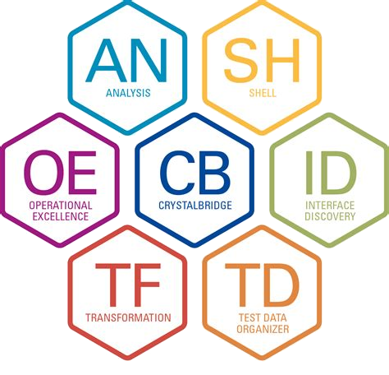
SDT Process Illustration Continuous Cutover Migration time minimization / optimization
2024
2025
2026
Dec
Jan
Feb
Mar
April
May
June
July
Aug
Sep
Oct
Nov
Dec
Jan
Feb
March
April
Project Start
5 weeks
14 weeks
27 weeks
6 weeks
Go Live
6 weeks
Mobilization
Analyze &
Design
Develop
Testing
Cut Over
Hypercare
Project
Soft Freeze
Change Freeze
Functional Unit Test
Go Live
Hypercare
TM0 Test
Cut Over Prep
System Integration Test
UAT
Data Validation
Data Validation
Create SDT MBP
TM1
TM2
GL Sim
SDT
Data Verification
First time consumption / indication of migration programs
Data Verification
Time consumption equal to Go-Live of migration programs
TM0
“< 48h total”
SNP Tools Platform
Continuous migration code optimization
Continuous migration code optimization
System optimization
System optimization
System optimization
Source system always copied from Prod
Target system always copied from previous phase pre-migration system
TM1, SRC2
TM2, SRC1
TM1, SRC2
Infra
structure
TM0, SRC1
P2A
*Go Live 1 = Bangladesch, Sri Lanka, Vietnam, Indonesia, Philippines, Singapore , India, Thailand, Malaysia
Regional
Corporate

Slide 20
Agenda – Day 2 Tuesday March 11th
Time | Topic | Details | Presenter
08.00h -09.00h
09.00h – 10.00h | SDT Plan | Technical Migration Cycles, Structure, GLS, ... | Tobias Hust, Anubhab Dasgupta
10:00h – 11:00h | Overview Project Landscape/ Change Freeze | Source Systems, Target Systems, Change Freeze, UC4 Jobs, ... | Sneha Dutta, Stephan Domes, Natarajan Thiyagarajan
11.00h – 12.00h | System Build Plan | Build Plan, Provisioning, ... | Sneha Dutta, Stephan Domes, Natarajan Thiyagarajan
12.00h – 13.00h | Lunch
13.00h – 14.00h | Testing Approach | TM0 Unit Test, FUT, SIT, UAT, Sign Offs, Test Tools, … | Pallavi Banerjee
14.00h – 15.00h | Satellites US & Mexico | Global Satellites, US local Satellites, Mexico Satellites | Leonard Eynon, Stuart Boyd, Martin Vega
15.00h – 16.00h | Cut Over Approach | Structure, Approach, Approvals, Governance, Stakeholders, Plan, Decision Points, … | Sneha Dutta, Stephan Domes
16:00h – 17.00h | Project Management | Project Organization, Stream set-up, Planning Approach | Sneha Dutta

Slide 21
S/4 HANA Landscape Transformation BOC-T Landscape
SAP ECC As-Is
S/4 HANA To-Be
ECC
S/4
US/MX
RUI
Afrox
RGC
RSE
US/MX
RUI
Afrox
RGC
RSE
RSK
P2E
PRD
P9E
P6E
P8E
P2A
P1A
P9A
P6A
P8A
P4A
S2E
S1E
S9E
S6E
S8E
Q2A
Q1A
Q9A
Q6A
Q8A
Q4A
D2A
D1A
D9A
D6A
D8A
D4A
DGE
One global development environment for all
One development environment per BOCT environment
For US/MX, S/4HANA Dev D2A created from a copy of ECC Production P2E
with all configuration and codebase and without data

Slide 22
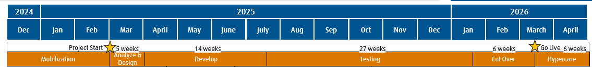
S/4 HANA Landscape Transformation Change Freeze
Soft Change Freeze
Hard Change Freeze
Retrofit of ECC changes into the S/4Hana environment is a continuous activity running the entire duration of the project
Besides consuming Regional and Corporate efforts, ECC system changes during the project risk
Impacting SDT migration design and
HANA Functional Testing
Changes to SDT migration design mid way during the test phases also bring financial risks of Change Requests
Strong sponsorship from regional leadership to keep ECC system changes to minimum during the project duration
Regional IT must play the role of guardians in keeping changes to minimum – managing business expectation is key

Slide 23
S/4 HANA Landscape Transformation UC4 Jobs
Categories
Cat 1: Both defined and scheduled in UC4 (UC4 Jobs) – can be directly imported = 333 jobs
Cat 2: Defined in ECC, but scheduled in UC4 – can be imported, but needs to be converted to Cat 1 = 270 jobs
Cat 3: Both defined and scheduled in ECC (Non-UC4 jobs) - Import and convert to Cat 1 = ~160 jobs
** All UC4 and SAP job changes needed to be synced between S/4 and P2E until cutover. This should start from S4A from the agreed timeline
** Only UC4 SAP jobs to be tested in SIT and UAT, no UNIX or FTP jobs
** AQ jobs/ queries if needed to be reviewed and adjusted supported by Chris K from Corp IT
Actions
Cat 1 & Cat 2:
Identify old/ obsolete/ unnecessary and stop them
New UC4 Batch User IDs from GIMs before UC4 Prep
UC4 Prep: timeline TBD
Cat 3:
Three options to be chosen from (where 3 is not recommended):
Identify the jobs that are old/ obsolete/ unnecessary and stop them in SAP
Identify the jobs that are needed and can be switched to UC4. Notify UC4 Team (Peter Kerschl & T-Systems): Import and convert to Cat 1: can be done in P2E (Move Cat 3 to Cat 1) until we do the UC4 Prep (copy to S4A (TM1))
If a job needs to remain within SAP and cannot be switched to UC4, you need to take the ownership of redefining these in Prod (to be included in Cutover plan), also determine if these need to be tested in UAT phase

Slide 24
Agenda – Day 2 Tuesday March 11th
Time | Topic | Details | Presenter
08.00h -09.00h
09.00h – 10.00h | SDT Plan | Technical Migration Cycles, Structure, GLS, ... | Tobias Hust, Anubhab Dasgupta
10:00h – 11:00h | Overview Project Landscape/ Change Freeze | Source Systems, Target Systems, Change Freeze, UC4 Jobs, ... | Sneha Dutta, Stephan Domes, Natarajan Thiyagarajan
11.00h – 12.00h | System Build Plan | Build Plan, Provisioning, ... | Sneha Dutta, Stephan Domes, Natarajan Thiyagarajan
12.00h – 13.00h | Lunch
13.00h – 14.00h | Testing Approach | TM0 Unit Test, FUT, SIT, UAT, Sign Offs, Test Tools, … | Pallavi Banerjee
14.00h – 15.00h | Satellites US & Mexico | Global Satellites, US local Satellites, Mexico Satellites | Leonard Eynon, Stuart Boyd, Martin Vega
15.00h – 16.00h | Cut Over Approach | Structure, Approach, Approvals, Governance, Stakeholders, Plan, Decision Points, … | Sneha Dutta, Stephan Domes
16:00h – 17.00h | Project Management | Project Organization, Stream set-up, Planning Approach | Sneha Dutta

Slide 25
System Landscape
Project Approach
DGE
S2E
P2E
Current Operational Landscape
ECC 6
Full Prod System Copy prior to Migration
Source
SRC1
SRC2
Go Live
Retrofit
Data Migration
Data Migration
PMG
Box 1
Box 2
Box 1
Box 2
Control Sys
TM0 S3A
(Unit Tests)
TM1 S4A
(SIT)
TM2 Q2A
(UAT)
Go Live Simulation S4A
Project
Landscape
Target
Transport Catch Up
System Copy post Go Live
D2A
Q2A
P2A
Future Operational Landscape
S/4

Slide 26
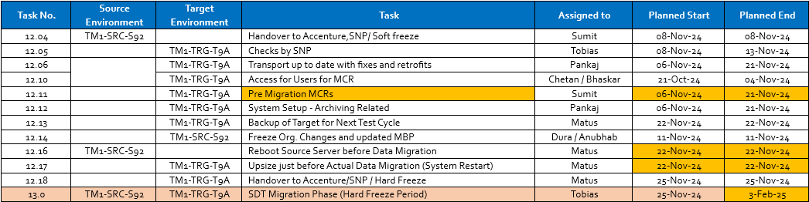
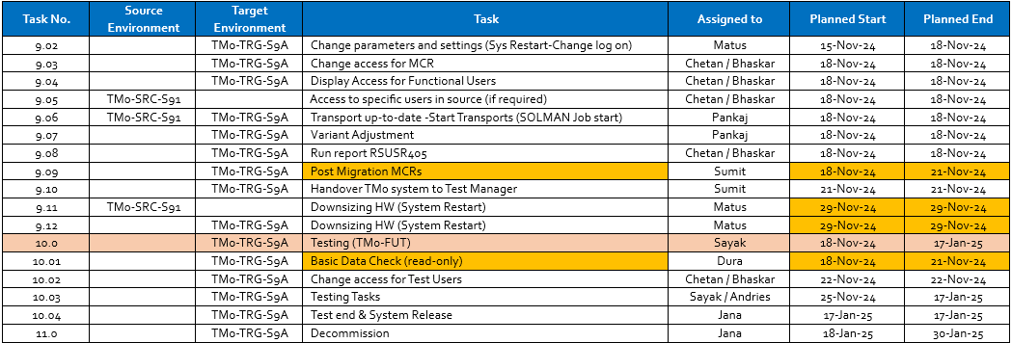
S/4 HANA Landscape Transformation Environment Plan
Example
Pre-Migration Steps
Post-Migration Steps

Slide 27
Agenda – Day 2 Tuesday March 11th
Time | Topic | Details | Presenter
08.00h -09.00h
09.00h – 10.00h | SDT Plan | Technical Migration Cycles, Structure, GLS, ... | Tobias Hust, Anubhab Dasgupta
10:00h – 11:00h | Overview Project Landscape/ Change Freeze | Source Systems, Target Systems, Change Freeze, UC4 Jobs, ... | Sneha Dutta, Stephan Domes, Natarajan Thiyagarajan
11.00h – 12.00h | System Build Plan | Build Plan, Provisioning, ... | Sneha Dutta, Stephan Domes, Natarajan Thiyagarajan
12.00h – 13.00h | Lunch
13.00h – 14.00h | Testing Approach | TM0 Unit Test, FUT, SIT, UAT, Sign Offs, Test Tools, … | Pallavi Banerjee
14.00h – 15.00h | Satellites US & Mexico | Global Satellites, US local Satellites, Mexico Satellites | Leonard Eynon, Stuart Boyd, Martin Vega
15.00h – 16.00h | Cut Over Approach | Structure, Approach, Approvals, Governance, Stakeholders, Plan, Decision Points, … | Sneha Dutta, Stephan Domes
16:00h – 17.00h | Project Management | Project Organization, Stream set-up, Planning Approach | Sneha Dutta

Slide 28
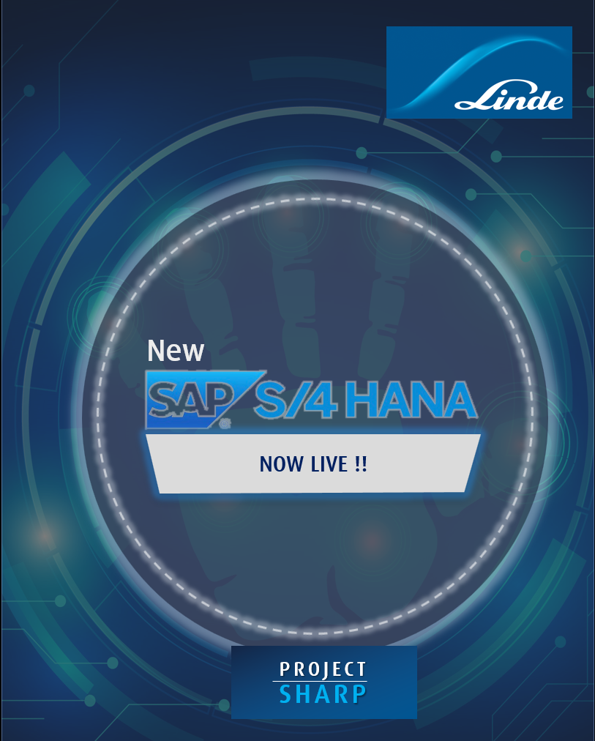
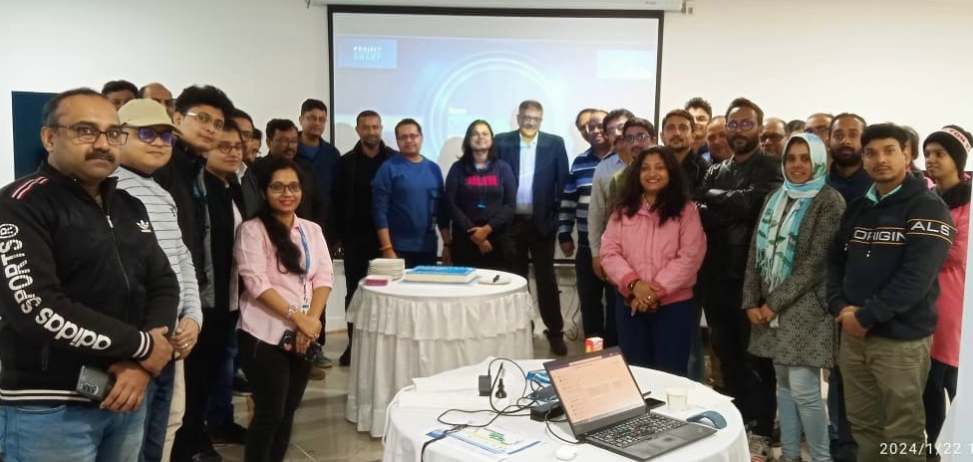
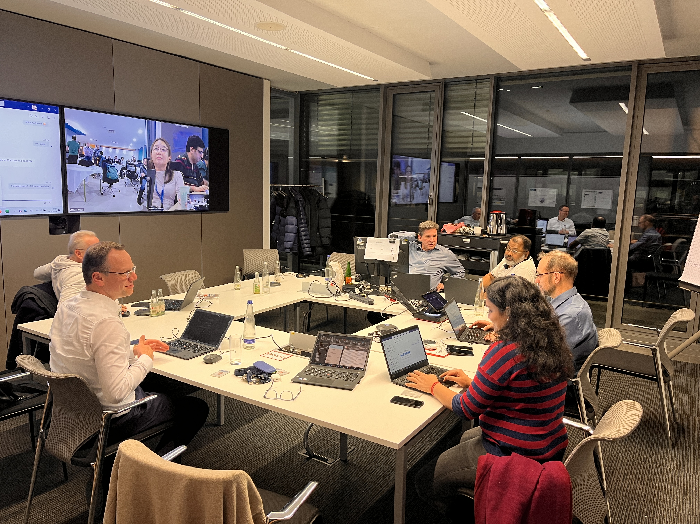
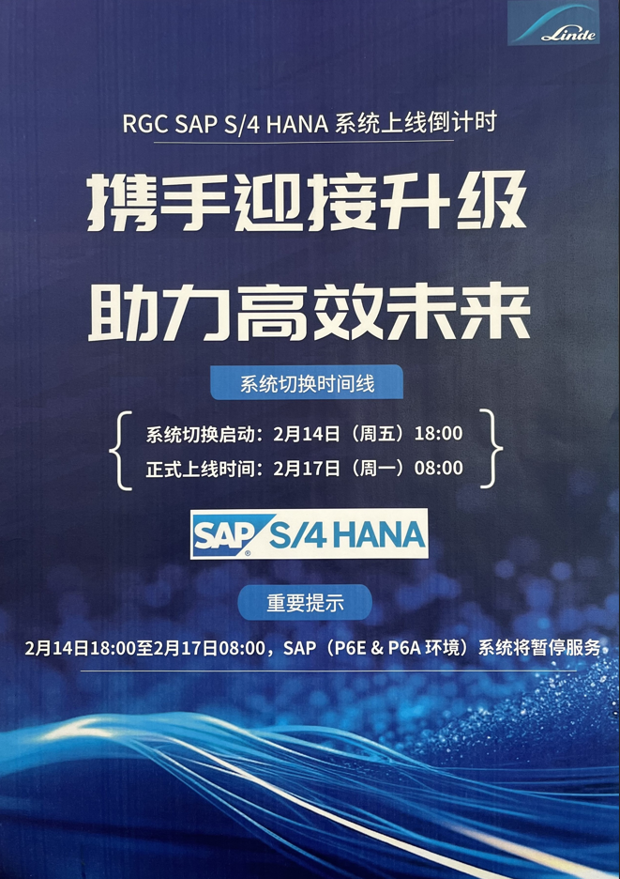
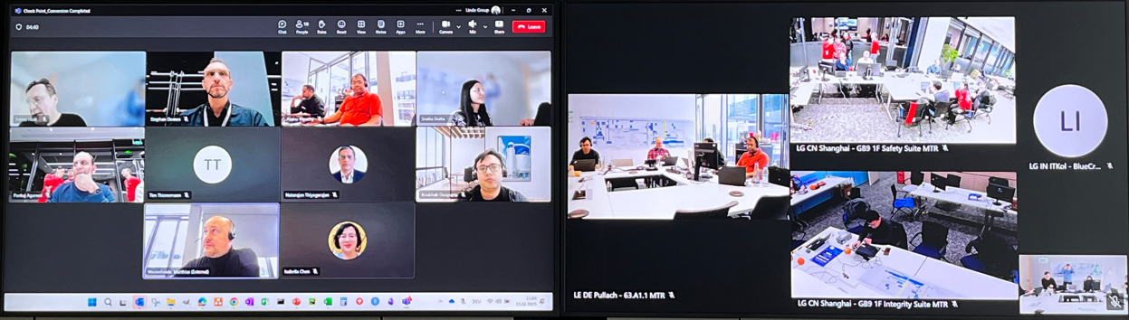
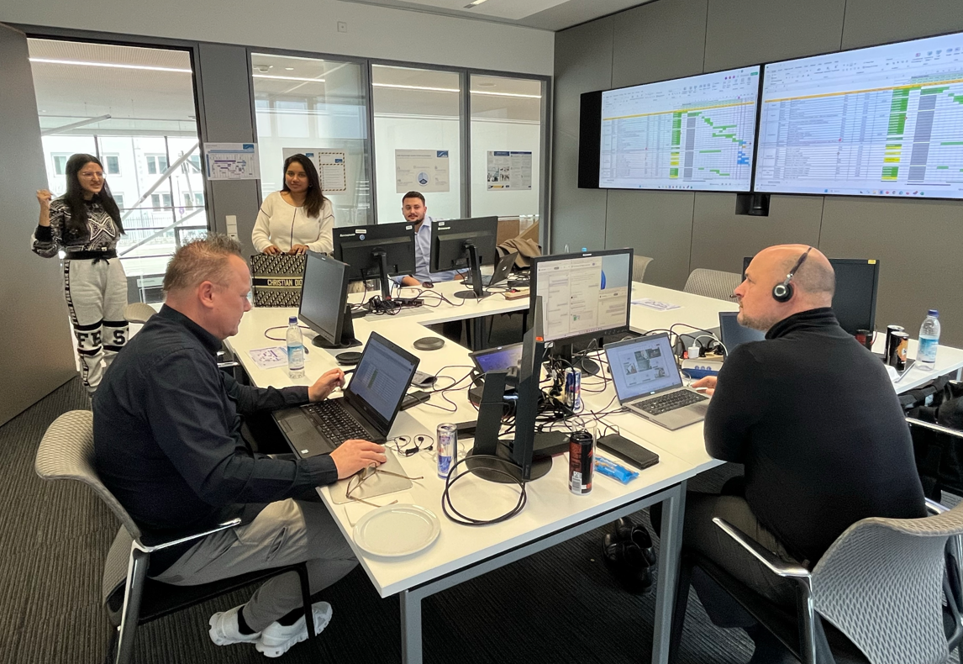
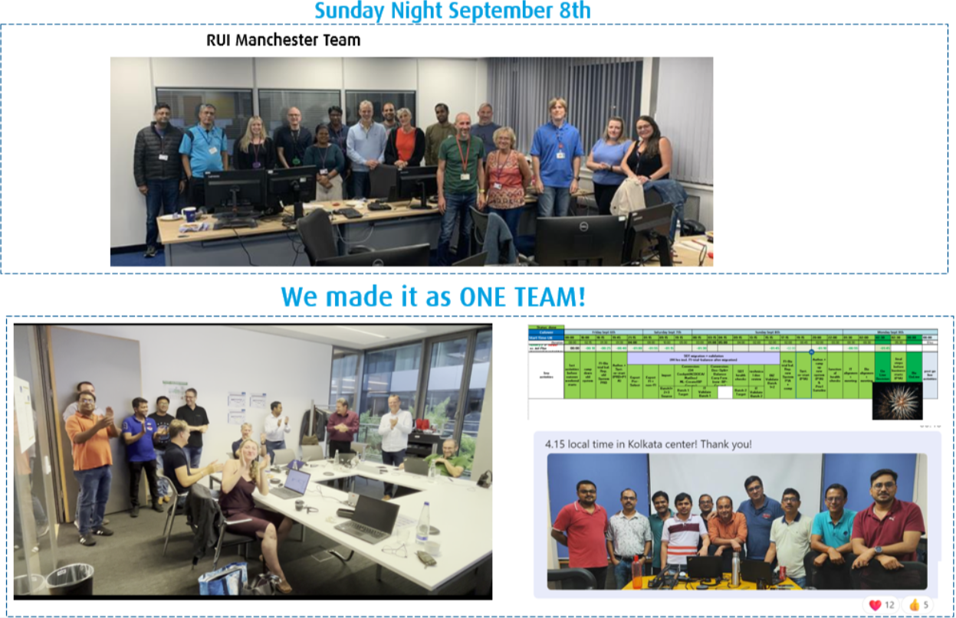
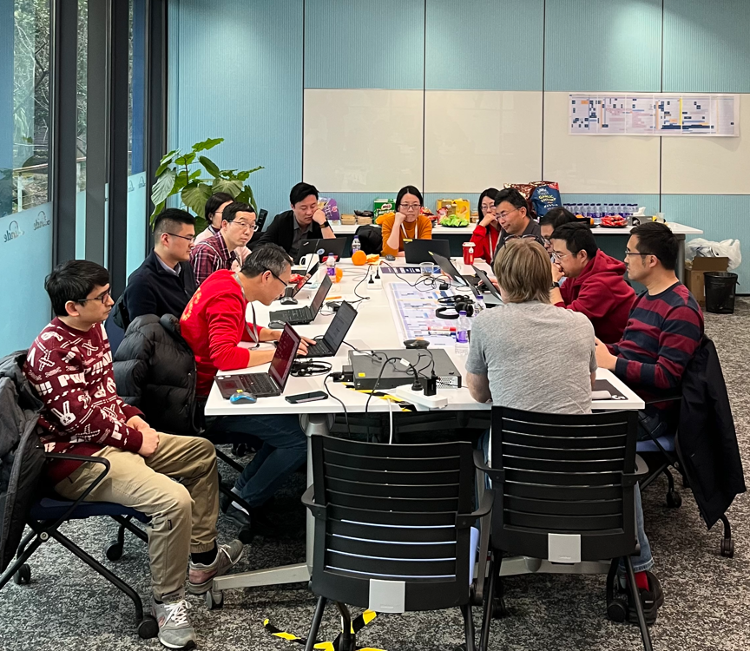
S/4 HANA Landscape Transformation Cut Over & Go Lives Impressions
RSE Go Live January 2024
RUI Go Live September 2024
RGC Go Live February 2025

Slide 29
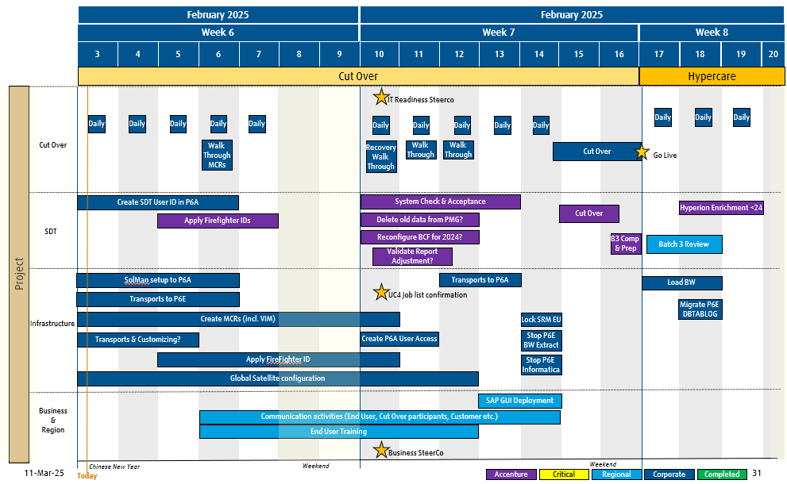
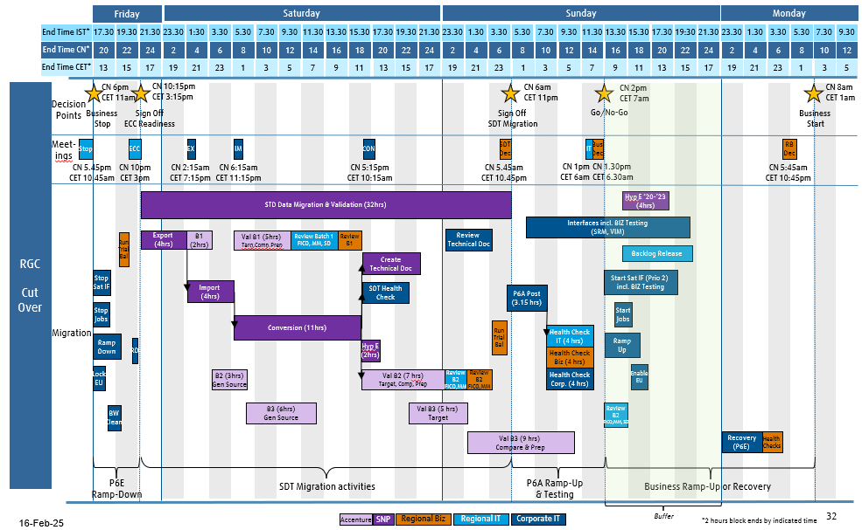
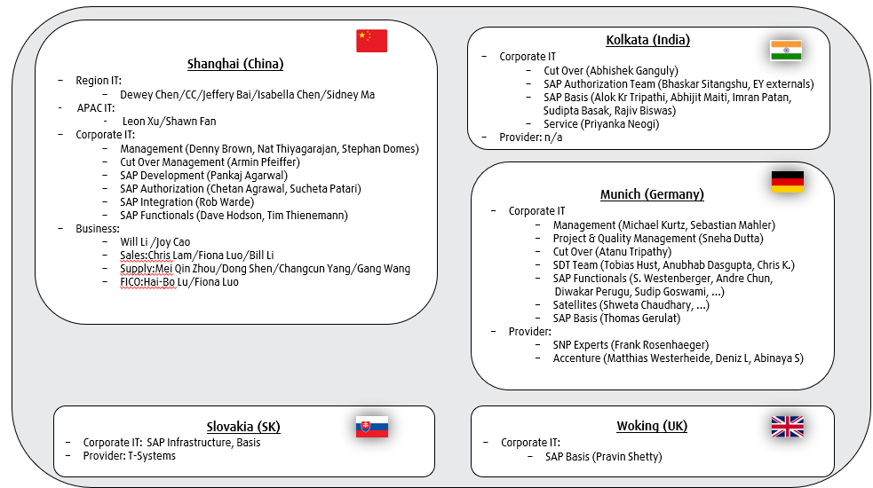
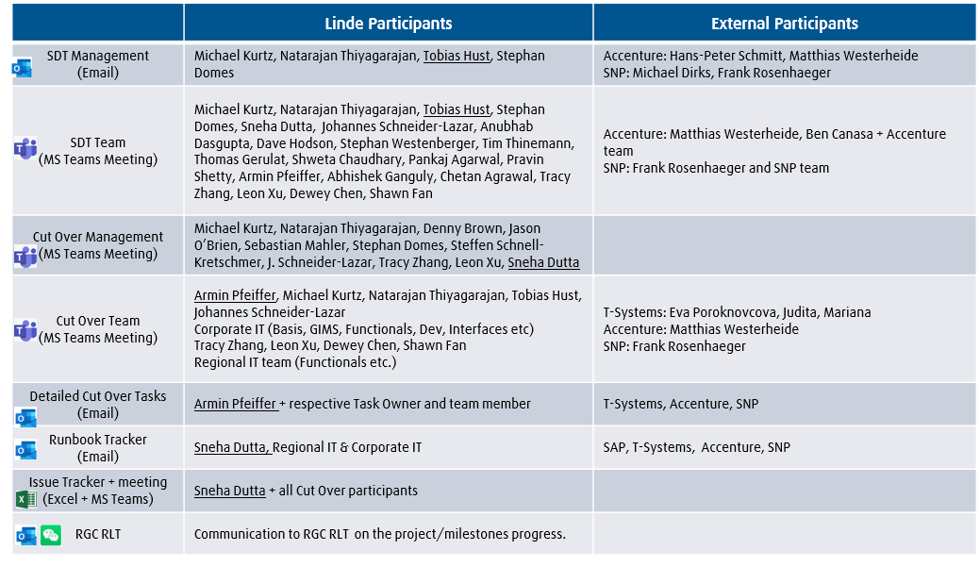
S/4 HANA Landscape Transformation Cut Over Management

Slide 30
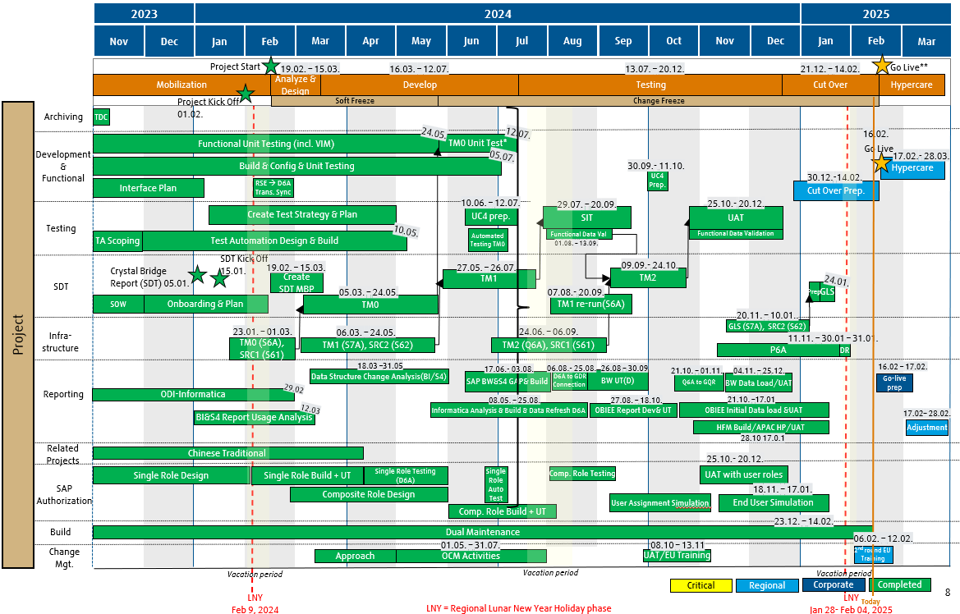
Project US & Mexico Key Messages Readiness
Dress Rehearsal completed and all findings mitigated
Corporate IT Team set- up completed and onsite support organized
Regional IT Team set-up completed and fully aligned
Business Steerco Cutover Decision: GO received
SOX activities agreed and team fully aligned
All providers (Accenture, SNP, T-Systems, SAP etc.) informed and fully aligned
Cut Over Weekend planning activities completed and shared with all stakeholders
Production (P6A) system set-up and Disaster Recovery test successfully completed
Hypercare approach
Watch Item: SAPGUI and SAPUILandscape deployment to RGC (SAP GUI Deployment_Cutover Readiness.xlsx)

Slide 31
Project US & Mexico Roadmap to Go Live Weekend
March 2026
Week 10
Week 11
Week 12
2
3
4
5
6
7
8
9
10
11
12
13
14
15
16
17
18
19
Cut Over
Hypercare
Project
IT Readiness Steerco
Daily
Daily
Daily
Daily
Daily
Daily
Daily
Daily
Daily
Daily
Daily
Daily
Daily
Cut Over
Walk
Through
MCRs
Recovery
Walk
Through
Walk
Through
Walk
Through
Cut Over
Go Live
Create SDT User ID in P2A
System Check & Acceptance
Cut Over
Hyperion Enrichment <24
SDT
Apply Firefighter IDs
Delete old data from PMG?
Reconfigure BCF for 2024?
B3 Comp
& Prep
Batch 3 Review
Validate Report
Adjustment?
SolMan setup to P2A
Transports to P2A
Load BW
Transports to P2E
UC4 Job list confirmation
Migrate P2E
DBTABLOG
Infrastructure
Create MCRs (incl. VIM)
Lock SRM EU
Transports & Customizing?
Create P2A User Access
Stop P2E
BW Extract
Apply FireFighter ID
Stop P2E
Informatica
Global Satellite configuration
Business
&
Region
SAP GUI Deployment
Communication activities (End User, Cut Over participants, Customer etc.)
End User Training
Business SteerCo
Weekend
Weekend
Accenture
Critical
Regional
Corporate
Completed

Slide 32
Project US & Mexico Cut Over Weekend (example)
Friday
Saturday
Sunday
Monday
End Time IST*
5.30
7.30
9.30
11.30
13.30
15.30
17.30
19.30
21.30
23.30
1.30
3.30
5.30
7.30
9.30
11.30
13.30
15.30
17.30
19:30
21.30
23.30
1.30
3.30
5.30
7.30
9.30
11.30
13.30
15.30
17.30
19:30
21.30
End Time EST*
20
22
24
2
4
6
8
10
12
14
16
18
20
22
24
2
4
6
8
10
12
14
16
18
20
22
24
2
4
6
8
10
12
End Time CET*
1
3
5
7
9
11
13
15
17
19
21
23
1
3
5
7
9
11
13
15
17
19
21
23
1
3
5
7
9
11
13
15
17
Cut
Over
EST 6pm
CET 1am
EST 10:15pm
CET 3:15am
EST 6am
CET 11am
EST 2pm
CET 7pm
EST 8am
CET 1pm
Decision
Points
Business
Stop
Sign Off
ECC Readiness
Sign Off
SDT Migration
Go/No-Go
Business
Start
Meet-
ings
RB
Dec
Stop
ECC
EX
IM
CON
SDT
Dec
IT
Bus
Dec
STD Data Migration & Validation (32hrs)
Hyp E ‘20-’23
(4hrs)
Review
Technical Doc
Interfaces incl. BIZ Testing
(SRM, VIM)
Run
Trial
Bal
Export
(4hrs)
B1
(2hrs)
Val B1 (5hrs)
Targ,Comp,Prep
Review Batch 1
FICO, MM, SD
Review
B1
Create
Technical Doc
Backlog Release
Stop
Sat IF
Import
(4hrs)
SDT Health
Check
Start Sat IF (Prio 2)
incl. BIZ Testing
P2A Post
(3.15 hrs)
Stop
Jobs
Start
Jobs
Migration
Conversion (11hrs)
Run
Trial
Bal
Health Check
IT (4 hrs)
Ramp
Down
RD
Hyp E
(2hrs)
Ramp
Up
Health Check
Biz (4 hrs)
Lock
EU
B2 (3hrs)
Gen Source
Val B2 (7 hrs)
Target, Comp, Prep
Review
B2
FICO,MM
Review
B2
FICO,MM
Health Check
Corp. (4 hrs)
Enable
EU
BW
Clean
B3 (6hrs)
Gen Source
Val B3 (5 hrs)
Target
Review
B2
FICO,MM, SD
Val B3 (9 hrs)
Compare & Prep
Recovery
(P2E)
Health
Checks
P2E
Ramp-Down
SDT Migration activities
P2A Ramp-Up
& Testing
Business Ramp-Up or Recovery
11-Mar-25
Accenture
SNP
Regional Biz
Regional IT
Corporate IT
Buffer
*2 hours block ends by indicated time

Slide 33
Cut Over Weekend Meeting Structure
Time (EST) | Time (CET) | Duration | Meetings | Presenter | Participants
5.45pm Friday, March 13 | 10.45pm Friday, March 13 | 15 min | Business Stop | Reg IT PM Corp IT PM | Regional IT Team Corporate IT (Mgt., GIMS, Basis, Functional, Cross App) Provider (Accenture/SNP, T-Systems)
9.45pm Friday, March 13 | 2.45am Friday, Feb 14 | 15 min | ECC Readiness | Corp IT PM Reg IT PM | Regional IT Team Corporate IT (Mgt., GIMS, Basis, Functional, Cross App) Provider (Accenture/SNP, T-Systems)
2:15am Sat, March 14 | 7:15am Sat, March 14 | 30 min | Check Point Export | Matthias Westerheide | Regional IT Team (Management, Functional) Corporate IT (Management, Functional) Provider (Accenture/SNP)
6:15am Sat, March 14 | 11:15am Sat, March 14 | 30 min | Check Point Import | Frank Rosenhaeger | Regional IT Team (Management, Functional) Corporate IT (Management, Functional) Provider (Accenture/SNP)
5:15pm Sat, March 14 | 10:15pm Sat, March 14 | 30 min | Check Point Conversion | Matthias Westerheide | Regional IT Team (Management, Functional) Corporate IT (Management, Functional) Provider (Accenture/SNP)
5:45am Sunday, March 15 | 10:45am Sunday, March 15 | 15 min | SDT Data Migration Sign off | Reg IT PM Matthias Westerheide | Regional IT Team Corporate IT (Mgt., GIMS, Basis, Functional, Cross App) Provider (Accenture/SNP) SOX Team
1pm Sunday, March 15 | 6pm Sunday, March 15 | 30 min | IT Alignment Go/No-Go | Corp IT PM Reg IT PM | Regional IT Team (Management, Functional) Corporate IT (Management, Functional)
1.30pm Sunday, March 15 | 6.30pm Sunday, March 15 | 30 min | Go/No-Go Decision | Reg IT PM/ Head | Business Management Regional IT Management Corporate IT Management
5:45am Sunday, March 16 | 10:45am Sunday, March 16 | 30 min | Recovery Confirmation | Reg IT PM Corp IT PM | Business Management Regional IT Management Corporate IT Management
Invite only needed in case of a no-go decision

Slide 34
Cut Over Weekend Decision Points
Decision Point | Decider | Criteria | Document
Business Stop | Regional IT Head | Shut down P2E business processes | Business process stopped Pre-ramp down activities completed
ECC Readiness | Regional IT Head | Successful completion of all P2E ramp-down activities and environment ready for SDT start | End users logged off incl. SOX FICO Satellites disconnected Job stopped BW Queue clean Trial Balance Reports executed P2E/P2A restart completed SDT P2E/P2A Authorization granted
SDT Data Migration Sign Off | Business/SOX Regional IT Head | Successful result of SDT Migration and Validation Reports Trial Balance Reports | Data Consistency Verification (no new defects) Comparison Report (1) Migration Cockpit Reports (4) Validate Report Batch 1 (82) Validate Report Batch 2 (27) SDT Health Check results SOX Trial Balance Report sign off
Go/No Go Decision | Business SteerCo Regional IT Head | Successful tests of Business Health Check Scope | SDT Migration results Prio 1 Satellites Readiness Health Check results Functional Test Results
Recovery Confirmation | Business SteerCo Regional IT Head | Successful roll-back set-up | P2E Readiness Interface Readiness Rollback Regional Test …

Slide 35



Cut Over Weekend Communication & Tools – MS Teams Meeting & Email
 | Linde Participants | External Participants
SDT Management (Email) | Michael Kurtz, Natarajan Thiyagarajan, Tobias Hust, Stephan Domes | Accenture: Hans-Peter Schmitt, Matthias Westerheide SNP: Michael Dirks, Frank Rosenhaeger
SDT Team (MS Teams Meeting) | Michael Kurtz, Natarajan Thiyagarajan, Tobias Hust, Stephan Domes, Sneha Dutta, Anubhab Dasgupta | Accenture: Matthias Westerheide, Ben SNP: Frank Rosenhaeger
Cut Over Management (MS Teams Meeting) | Michael Kurtz, Natarajan Thiyagarajan, Denny Brown, Dulce Borjas, Adrian Espinosa, Pete Casazza, Sebastian Mahler, Stephan Domes, Steffen Schnell-Kretschmer, J. Schneider-Lazar, Sneha Dutta
Cut Over Team (MS Teams Meeting) | Armin Pfeiffer, Michael Kurtz, Natarajan Thiyagarajan, Tobias Hust, Johannes Schneider-Lazar Corporate IT (Basis, GIMS, Functionals, Dev, Interfaces etc) Derek Punaro, Yiliana Mellado etc. Regional IT team (Functionals etc.) | T-Systems: Eva Poroknovcova, Judita, Mariana Accenture: Matthias Westerheide SNP: Frank Rosenhaeger
Detailed Cut Over Tasks (Email) | Armin Pfeiffer + respective Task Owner and team member | T-Systems, Accenture, SNP
Runbook Tracker (Email) | Sneha Dutta, Regional IT & Corporate IT | SAP, T-Systems, Accenture, SNP
Issue Tracker + meeting (Excel + MS Teams) | Sneha Dutta + all Cut Over participants
US & MX RLT | Communication to RGC RLT on the project/milestones progress.

Slide 36






Cut Over Weekend Resource Planning
Hampton (USA)
Region IT:
..
- .
Corporate IT:
Management (tbd)
Cut Over Management (tbd)
SAP Development (tbd)
SAP Authorization (tbd)
SAP Integration (tbd)
SAP Functionals (tbd)
Business:
..
Kolkata (India)
Corporate IT
Cut Over (tbd)
SAP Authorization Team (tbd)
SAP Basis (tbd)
Service (tbd)
Provider: n/a
Munich (Germany)
Corporate IT
Management (tbd)
Project & Quality Management (tbd)
Cut Over (tbd)
SDT Team (tbd)
SAP Functionals (tbd)
Satellites (tbd)
SAP Basis (tbd)
Provider:
SNP Experts (Frank Rosenhaeger)
Accenture (Matthias Westerheide, etc.)
Monterrey (Mexcio)
Region IT:
..
- .
Corporate IT:
Management (tbd)
SAP Development (tbd)
SAP Integration (tbd)
SAP Functionals (tbd)
Business:
..
Slovakia (SK)
Corporate IT: SAP Infrastructure, Basis
Provider: T-Systems
Woking (UK)
Corporate IT:
SAP Basis (tbd)

Slide 37
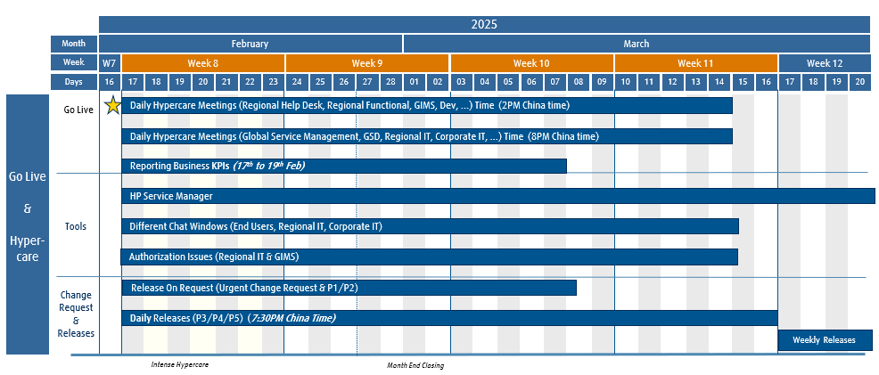
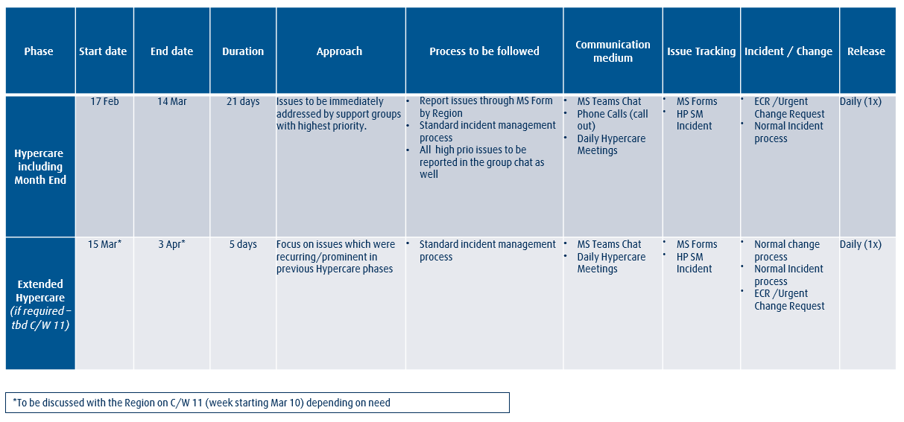
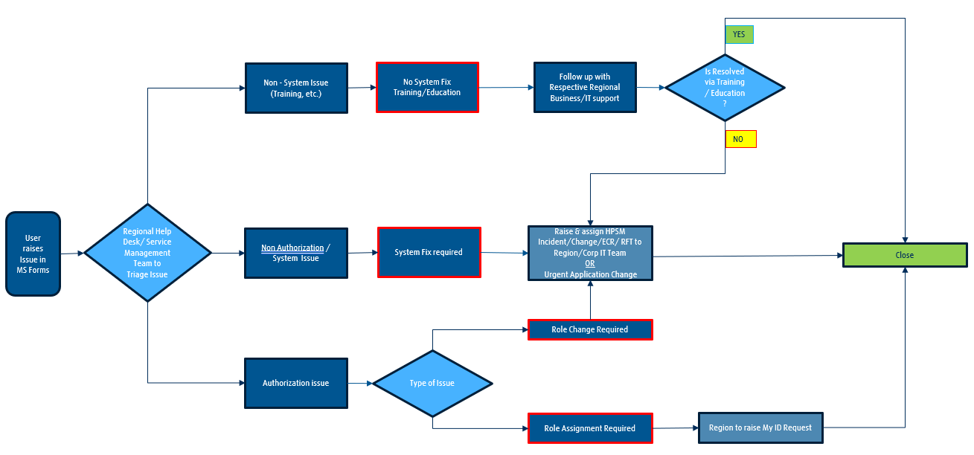
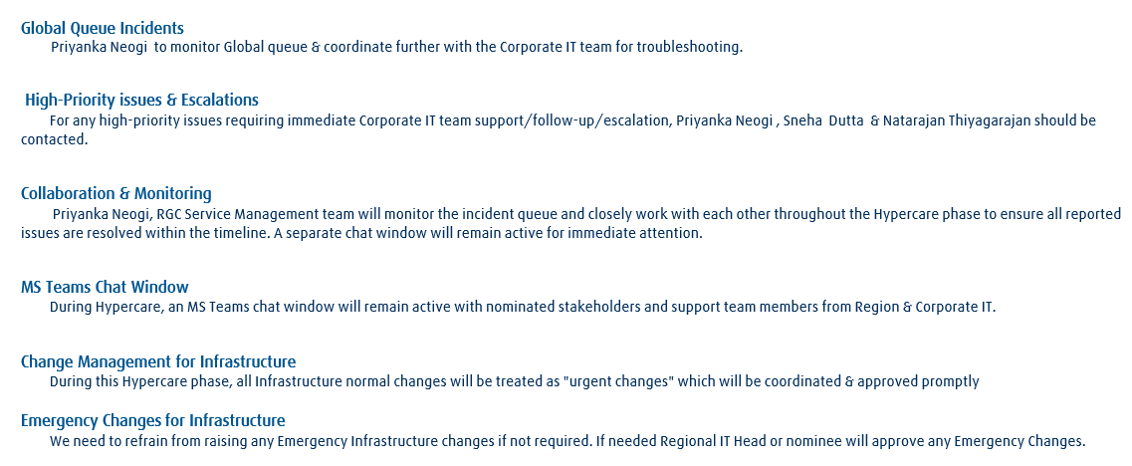
S/4 HANA Landscape Transformation Hypercare Management
Timeline
Setup
Issue Handling
Issue Management

Slide 38
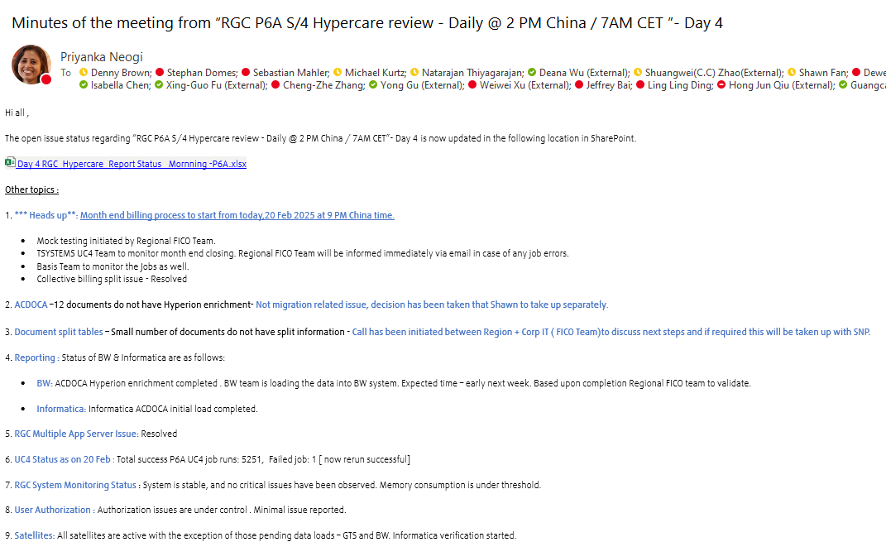
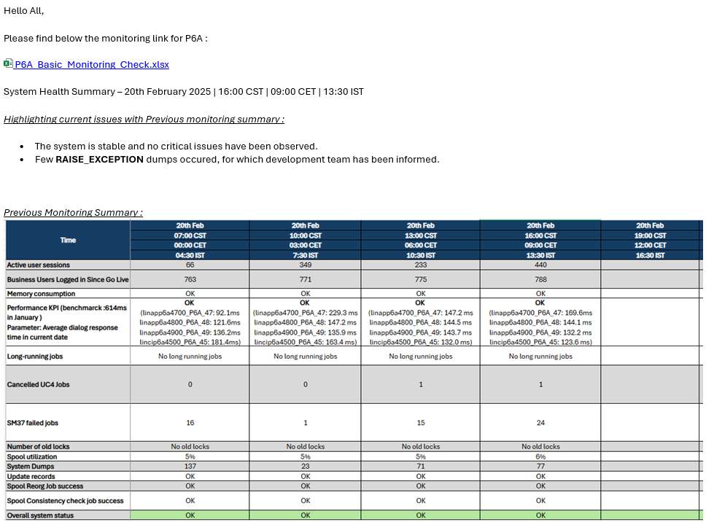
S/4 HANA Landscape Transformation Hypercare Management
Daily Hypercare Calls
Daily System Monitoring
Focus is on topics like
Reviewing critical incidents
Fast reaction on any type of issues
Preparation and ensuring Month End Closing activities
Providing full transparency after go live
Daily monitoring includes:
User behaviour (e.g. active user sessions, business users logged on since go live)
System Health (e.g. System Dumps, Spool utilization)
System Performance
UC4 Job (e.g. long running jobs, cancelled jobs)

Slide 39
Agenda – Day 2 Tuesday March 11th
Time | Topic | Details | Presenter
08.00h -09.00h
09.00h – 10.00h | SDT Plan | Technical Migration Cycles, Structure, GLS, ... | Tobias Hust, Anubhab Dasgupta
10:00h – 11:00h | Overview Project Landscape/ Change Freeze | Source Systems, Target Systems, Change Freeze, UC4 Jobs, ... | Sneha Dutta, Stephan Domes, Natarajan Thiyagarajan
11.00h – 12.00h | System Build Plan | Build Plan, Provisioning, ... | Sneha Dutta, Stephan Domes, Natarajan Thiyagarajan
12.00h – 13.00h | Lunch
13.00h – 14.00h | Testing Approach | TM0 Unit Test, FUT, SIT, UAT, Sign Offs, Test Tools, … | Pallavi Banerjee
14.00h – 15.00h | Satellites US & Mexico | Global Satellites, US local Satellites, Mexico Satellites | Leonard Eynon, Stuart Boyd, Martin Vega
15.00h – 16.00h | Cut Over Approach | Structure, Approach, Approvals, Governance, Stakeholders, Plan, Decision Points, … | Sneha Dutta, Stephan Domes, Natarajan Thiyagarajan
16:00h – 17.00h | Project Management | Project Organization, Stream set-up, Planning Approach | Sneha Dutta

Slide 40
Project S/4 HANA US & Mexico Project Plan
2024
2025
2026
Dec
Jan
Feb
Mar
April
May
June
July
Aug
Sep
Oct
Nov
Dec
Jan
Feb
March
April
Project Start
5 weeks
14 weeks
27 weeks
6 weeks
Go Live
6 weeks
Mobilization
Analyze &
Design
Develop
Testing
Cut Over
Hypercare
Project
Archiving
Archiving execution
Soft Freeze
Change Freeze
Archiving completed
Run COW activities
Trail Balance, Testing
Sign Off Cut Over
Functional Unit Testing
TM0 Unit Test
Go Live
Development
&
Functional
Build & Config & Unit Testing
Prepare Test Cases
Execute Test Cases
Defect retesting
Sign Off UAT
Cut Over Prep
09.03.26
6 weeks
Interface Planning
3 weeks (2. – 20.02.)
Hypercare
Create Test Strategy & Plan
Dress Reh
Kick Off
Test Automation Build
8 weeks (18.8. -10.10.)
9 weeks (24.11. – 23.1.)
Project Management (Financial, Gov)
SIT
UAT
xyz
(Add-On)
Define Validation Scope
Sign Off Migration Rules
Type: Workshops
Functional Data Val.
Functional Data Validation
Prepare CO Plan
Support DR incl. GLS
Sign Off CO Approach
Type: Workshops
Add-Ons
8 weeks (23.06. – 15.08.)
6 weeks (13.10. – 21.11.)
5 weeks (3.3. – 04.04.)
2 weeks
SDT
SDT MBP
11 weeks (07.04. – 20.06.)
TM1
TM2
GL Sim
Onboarding & Plan
TM0
8 weeks
6 weeks
6 weeks
System
build
TM0, SRC1
TM2, SRC1
GLS (T8A)
12 weeks
15 weeks
1 week
TM1 (T8A), SRC2
Productive P2A
DR
Analysis
Dashboard analysis & configure
Reporting
BW Queries & S4 HANA Gap analysis & build
Dev BW to GDR
Local extractor analysis & build
Related Projects
Review Single Role
Type: Workshops
xyz
Single Role Design
Single Role Build
Define Composite Roles
Type: Workshops
Mapping EU
Connect to new S/4HANA
SAP
Authorization
Single Role Test
Job/Composite Role Design
Job/Comp. Role Build
Comp. Role Test
EU Simulation
Development
Dual Maintenance
Change Mgt.
Approach
Build Training Material
Train-the-Trainer
Prep
EU Training
Stakeholder Management
Provide Communication Material
Business SteerCo Management
Vacation period
Regional
Corporate

Slide 41
Project S/4 HANA US & Mexico Organization
To be established
S/4 HANA Program SteerCo
Biz Steer Co US
Project Streams
Americas IT JF
Mark Alexion (Sales), Bill Heintz (Ops), John J. Byrne (Commerce), Adam G. Schmidt (Finance) Pete Casazza, Derek Punaro, Stuart Boyd
Dulce Borjas, Pete Casazza, Adrian Espinosa, Michael Kurtz, Goran Cederwall, …
Denny Brown
Leon Xu, Danny Perri, Dulce Borjas, Michael Kurtz, Goran Cederwall, …
PM Core Group
Biz Steer Co Mexico
Derek Punaro, Rodolfo Ortiz Chavarin, Stuart Boyd, Stephan Domes, Natarajan Thiyagarajan, Sneha Dutta, Pete Casazza (optional), Adrian Espinosa (optional)
Established
RBU Head, Head Finance, Operations, Deliver, Adrian Espinosa, …
Global
Program Manager
Stephan Domes
Deployment Manager
US
Deployment Manager
Mexico
Global
Deployment Manager
Derek Punaro
Leticia Mellado
Sneha Dutta
Integration Manager
Delivery & Integration
Stuart Boyd
Natarajan Thiyagarajan
BPO US
BPO Mex
Fico Team
Interfaces
Environment
Manager
Selective Data
Transformation
Finance & Controlling
Co-Ordinator
Finance & Controlling
Co-Ordinator
US – FICO, Stuart Boyd
MX – Rodolfo Ortiz Chavarin
Rutuja RW, Pradeep K (E)
Leonard Eynon
Atanu Tripathy
Tobias Hust (Lead)
Anubhab D. (Functional)
David Wright
Enrique Mar
Supply Team
Authorization Lead
Test Lead
Infrastructure
Product to Order
Co-Ordinator
Product to Order
Co-Ordinator
US – Plant M., S Boyd
US – Procurement, MX – Plant M.
Anders E (Plant M), Shweta C (Proc) Gaurav B
US – Tracy Herbert
MX – Dario Hernandez
Corporate IT
Angela Radford
Carlos Fernandez
Pallavi Banerjee
Pravin Shetty
Order to Cash
Co-Ordinator
Order to Cash
Co-Ordinator
Sales Team
Data Migration
Corporate IT
Functional
SAP Authorizations
Peggy Lee
Enrique Mar
US – Sales OTC
Wolfram Schenker, Sudipto D
US – Nikki Nelson
MX – Martin Vega
Dave Hodson
Stephan Westenberger
Anubhab Dasgupta
Shweta Chaudhary
Gellert Kovacs
Regional Business
Procurement
Co-Ordinator
Procurement
Co-Ordinator
Cutover
Derek Holtman
Diana Martinez
Test Lead
US – Nikki Nelson
MX – no
Armin Pfeiffer
Interfaces
BW Reporting
Pallavi Banerjee
Leonard Eynon
Juergen Mohr
Pricing
Co-Ordinator
Pricing
Co-Ordinator
BW, Reporting
Hypercare
Development
Cut Over
Regional IT
Kevin Schmalz Jason Fawcett
Enrique Mar
US – Anne Leung
US – Derek Punaro
MX - no
Pankaj Agarwal
Armin Pfeiffer
Corp Resource , External local Resource

Slide 42
Project S/4 HANA US & Mexico Stream Leads
Draft
Stream | Corporate IT SME | Regional IT SME | Overall Stream Lead
Archiving | Tanja Münz, Pankaj Agarwal | Weley Lieu | Simona Roth
Basis + Infrastructure | Pravin Shetty | Ankur Gupta | Thomas Gerulat
Reporting | Juergen Mohr | Shawn Fan | Mala Mani
Add-on | Falko Kretzschmar | Respective functional Stream Lead | Weley Lieu
Add-On VIM | Tim Thienemann (upgrade) | Surya Reddy | Surya Reddy
Corporate Satellite | Robert Warde | Sudip Goswami, Angnapatt Pattaraluck | Rob Warde
Local Satellite | Robert Warde | Sudip Goswami, Angnapatt Pattaraluck | Sudip Goswami
IDM (Authorization) | Chetan Agrawal | Weley, Anantharaman Govindarajan | Gellert Kovacs
Development | Development team | Respective functional Stream Lead | Pankaj Agarwal
Functional | Respective functional leads | Respective functional Stream Lead | Ganga Ponnampalam
Selective Data Transformation | Anubhab Dasgupta | Shafiul Bhuiyan | Tobias Hust
Testing | Andreas Aigner | Derek Che | Derek Che
Change Management | n/a | Tbd | Sujoy Sen
Cutover/Hypercare/Release | Armin Pfeiffer | Weley Lieu | Weley Liu
Stream | Corporate IT SME | Regional IT SME US | Regional IT SME Mex | Stream Lead
Archiving | Pankaj Agarwal | Stuart Boyd | Martin Vega | Simona Roth
Basis + Infrastructure | Pravin Shetty | TBD | TBD | Pravin Shetty
Reporting | Stefanie Waldert | Anne Leung | Martin Vega | Juergen Mohr
Add-on (e.g., EPP) | Stephan W., Anubhab D., Dave Hodson | Stuart Boyd | n/a | Stuart Boyd
Interfaces incl Corporate Satellite (Interfaces) | Leonard Eynon | Leonard Eynon | Leonard Eynon | Leonard Eynon
Local Satellite (Interfaces) | n/a | TBD | TBD | Leonard Eynon
IDM (Authorization) & Roles | Chetan Agrawal | TBD | TBD | Gellert Kovacs
Development | Pankaj Agarwal | Stuart Boyd | Rodolfo Ortiz Chavarin | Pankaj Agarwal
Functional | Stephan W., Anubhab D., Dave Hodson | Stuart Boyd | Rodolfo Ortiz Chavarin
Selective Data Transformation | Anubhab Dasgupta | Stuart Boyd | Rodolfo Ortiz Chavarin | Tobias Hust
Testing | Pallavi Banerjee | Pallavi Banerjee | Pallavi Banerjee | Pallavi Banerjee
Change Management | n/a | Derek Punaro | Martin Vega/ Leticia Mellado | n/a
Cutover/Hypercare/Release | Armin Pfeiffer | TBD | TBD | Armin Pfeiffer
Service Management | n/a | Kasey Quigley | Martin Vega

Slide 43
Project S/4 HANA US & Mexico Roles & Responsibilities 1/3
Role | Responsibilities
Biz SteerCo US & Mexico | Is accountable for US & Mexico project deployment as Project Sponsor Is accountable for reviewing the project status, including planned and actual time and costs as well as estimates to complete Provides direction on project related issues such as business/functional resources, priorities, change requests, budget challenges, etc. Approves gates and milestones, including go-live and project closure Takes management decisions, implement decisions and take actions in their functional area Serves as escalation function Monitors the ‘people change’ aspect of the project Supports communication to respective organizational units
Americas IT Jour Fix | Is accountable for Americas project deployments Is accountable for reviewing the Americas project status, including planned and actual time and costs as well as estimates to complete Provides direction on Americas project related issues such as IT resources, priorities, change requests, budget challenges, etc. Approves gates and milestones, including go-live and project closure Takes IT management decisions, implement decisions and take actions in their functional area Serves as escalation for all IT function Monitors the IT risks and mitigate those
Global Program Manager | Is accountable for planning and designing the S/4HANA program and proactively monitoring its progress, resolving issues and initiating appropriate corrective action Aligns the plan across all projects and ensures Corporate IT milestones and delivery tasks are kept Secures Corporate IT resources including Corporate IT managed suppliers Serves as escalation function Ensures learnings will be shared across different regional S4 HANA projects Communicates to Program and Project Steering Committee
Global Deployment Manager | Is accountable for delivering the project in time according to the defined Corporate IT objectives and deliverables Is a SPoC for US & Mexico Deployment Manager Manages the Corporate IT scope and any possible scope changes Plans and tracks Corporate IT project activities and costs, and ensures that the project is delivered in budget Requests, on-boards and ensures Corporate IT project resources Manages escalated Corporate IT issues and risks (mitigation, resolution etc.)

Slide 44
Project S/4 HANA US & Mexico Roles & Responsibilities 2/3
Role | Responsibilities
US & Mexico Deployment Manager | Is accountable for US & Mexico project delivery Is accountable for delivering the project in time according to the defined objectives and deliverables Is a SPoC for all project participants and stakeholders Works closely with the regional Steering Committee to ensure goals and objectives are met Works closely with the respective project stream leads Manages the scope and any possible scope changes Plans and tracking project activities and costs, and ensuring that the project is delivered in budget Requests, on-boards and ensures project resources Manages escalated issues and risks (mitigation, resolution etc) Is responsible for change management activities by collaboration with business coordinators Is responsible for keeping the key project documents up-to-date (e.g. RAID, status reporting, project plan, progress tracking) Reports proactively any risks and issues to the project management core group
US & Mexico Integration Manager | Accountable for all functional and technical deliverables of the US & Mexico team as described in the (Functional) Team Lead scope Ensures timely delivery, quality of all underlining streams e.g., Data, Testing, Interface, SD, Supply Assigns tasks to project resources, and manages the US & Mexico IT team Manages issues and risks (mitigation, resolution and/or escalation) Ensures smooth co-ordination of all technical streams and interface corporate IT tech/functional responsible
Global Delivery & Integration Manager | Is responsible for effectively integrating key activities of the Corporate and Regional teams for the successful integrated delivery of the US & Mexico Project Is responsible for securing Corporate IT Application resources
US & Mexico PMO Coordinator | Is accountable for day-to-day project management of regional activities Is accountable for monitoring, tracking and report project status

Slide 45
Project S/4 HANA US & Mexico Roles & Responsibilities 3/3
Role | Responsibilities
US & Mexico (Functional) Team Lead | Is accountable for preparation and execution of Functional Testing Is accountable for preparation of Integration Testing and UAT (e.g. test data, test environment, test cases/scenarios) Supports during the execution of the Integration Testing and UAT Supports for Business related testing activities Manages test defects handling and monitoring across all test cycles Provides regular test status reports to project manager across all test cycles Ensures SAP functional and process expertise will be provided Ensures completeness and timeline for set-up of the Integration/UAT test landscape across all regions Provides regular Integration /UAT landscape status reporting to project manager Plans, prepares and executes the Cut Over activities Provides regular Cut Over status reporting to project manager
US & Mexico Business Coordinators | Is accountable for acting as prime contact to the S/4 HANA business analysts during the project & sign-off the scope statement. Communicates to the respective key user community within all RAF countries Identification of risks or issues which could have an impact on business activities (e.g. testing) Supports conflicts resolution related to key user activities (availability of key users during the test phase, non-aligned business processes etc.) Integration Testing and User Acceptance Test for Completeness of the test scenarios/test cases Execution of the test scenarios/test cases Sign off UAT results

Slide 46
Project S/4 HANA US & Mexico RASCI
R = Responsible for the actual performance of the task/ activity.
A = Accountable means ultimately answerable for the correct and thorough completion of the deliverable or task
C = Consulted are those whose opinions are sought, typically subject matter experts; and with whom there is two-way communication
S = Support means the role or party that may provide input to the task; support helps complete the task or activity.
I = Informed are those who are kept up to date on progress, often only
Activity | Activity Description | Corporate IT | Regional IT | Business
Archiving | Plan, coordinate, execute and monitor all Archiving standard objects related activities | A, R | S | S
Archiving | Definition of Residence and Retention times | C | A, R | S
Analyze & Design | Create technical global specification (interfaces, simplification & compatibility, add-ons, …) | A, R | C | I
 | Create technical regional specification (interfaces, simplification & compatibility, add-ons, …) | C | A, R | I
Build & Configuration | Plan, develop, monitor progress of global build and configuration (e.g. eChannel) | A, R | S | C
Build & Config | Plan, develop, monitor progress of regional build and configuration (e.g. Telequery) | S | A, R | C
Authorization | Coordinate, plan, migrate and configure S/4HANA roles enforced by S/4HANA | A, R | S | C
 | Analyze and define US & Mexico specific roles scope (e.g. Firoi, SoD), test and sign off overall role build | C | A, R | I
Testing (SIT, UAT) | Coordinate, planning, test case creation, test execution, resolve regional defects, sign off | C | A | R
 | Resolve global defects, create and update automated test scripts | A, R | S | C, I
Infrastructure | Plan and provide infrastructure | A, R | C | I
Infrastructure | Plan and provide regional infrastructure including printers, local satellite connections | C | A, R | I
Selective Data Transformation | Coordinate, planning and execution, SDT Go Live Simulation | A, R | C | I
Selective Data Transformation | Definition of mapping rules | S | A | R
Change Management | Project Communication and training & education activities | C | R | A
Cut Over | Go Live Simulation, Cut Over organization, planning and execution, … | A, R | R | S
Hypercare | Plan and execute Hypercare related activities | S | A, R | S
Project Management | Plan, execute and proactively monitor progress of Corporate IT project deliverables, resolving issues and initiating appropriate corrective action | A, R | S | I
 | Overall project ownership Plan, execute and proactively monitor progress and regional project deliverables, resolving issues and initiating appropriate corrective action | S | A, R | S

Slide 47
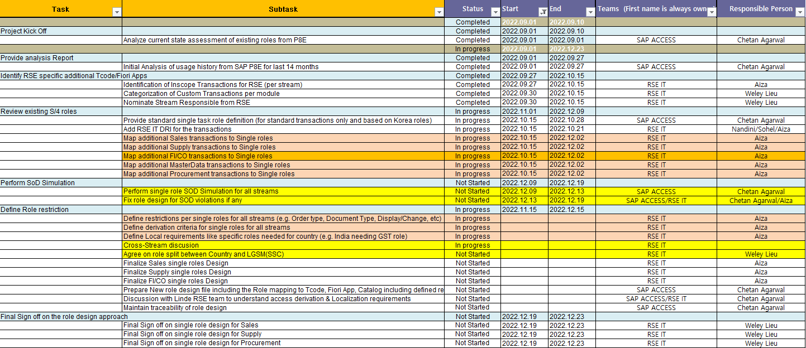
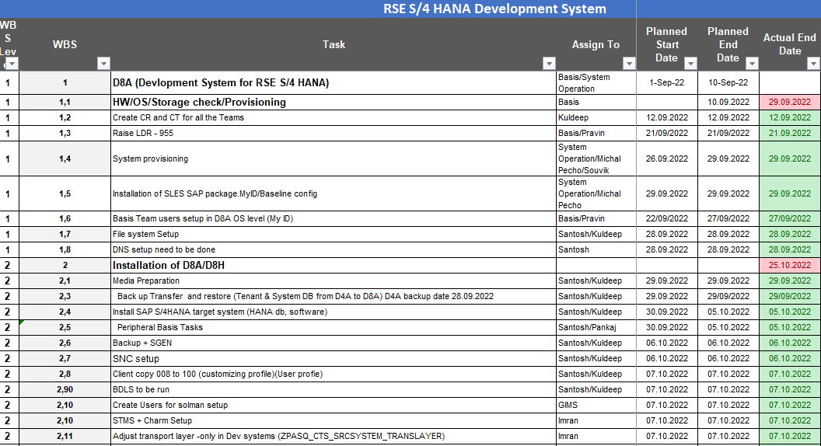
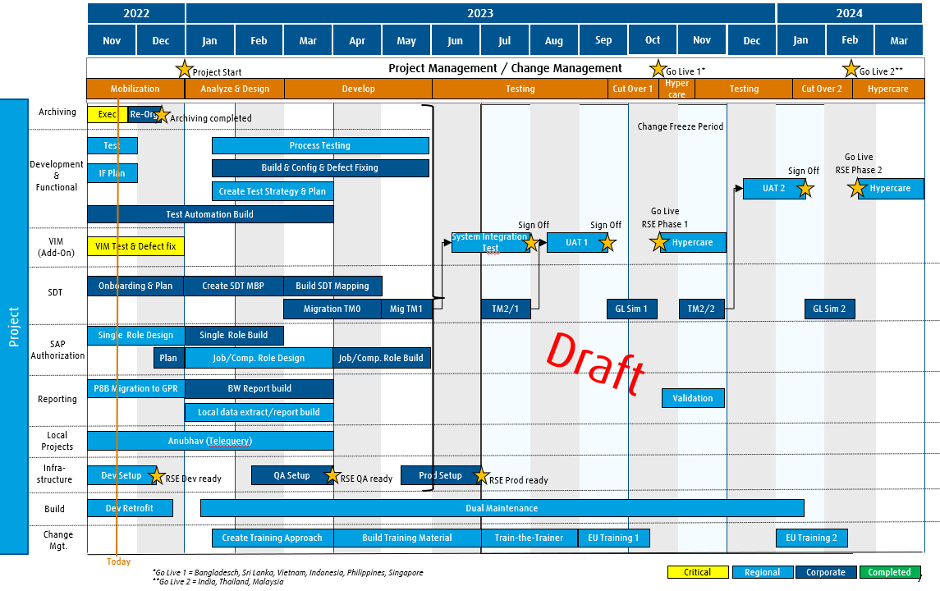
Project S/4 HANA US & Mexico Project Planning Approach
Project Streams
Overall Project Plan
(high level)
Test Migration 0
Test Migration 1
Test Migration 2
Go Live Simulation
Owned by SDT (Corporate)
SDT Plan
Operations Systems:
Dev (D2A), QA (Q2A), Prod (P2A)
Project Systems:
Source 1, Source 2, TM0, TM1, TM2, GLS
Owned by Basis (Corporate)
Infrastructure Plan
Infrastructure Plan
Single Role Build
Composite Role Design
Composite Role Build
Owned by Roles (Corporate)
SAP Authorization Plan
Functional Unit Testing
System Integration Test
UAT
Owned by Test Mgr. (Corporate)
Owned by Environment Mgr. (Corporate)
Test Plan
Environment Plan
BW & Informatica
Development
Customizing, FIORI
Interfaces
Owned by Region
New Build Plan
Cut Over Plan
Cut Over Weekend Plan
Owned by Cut Over Mgr. (Corporate)
Cut Over Plan
Train-the-Trainer Plan
End User Training Plan 1
End User Training Plan 2
Owned by Region
Change Management Plan

Slide 48
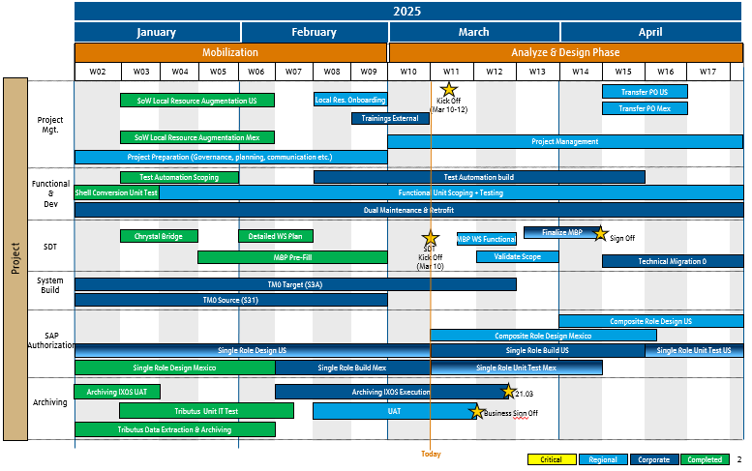
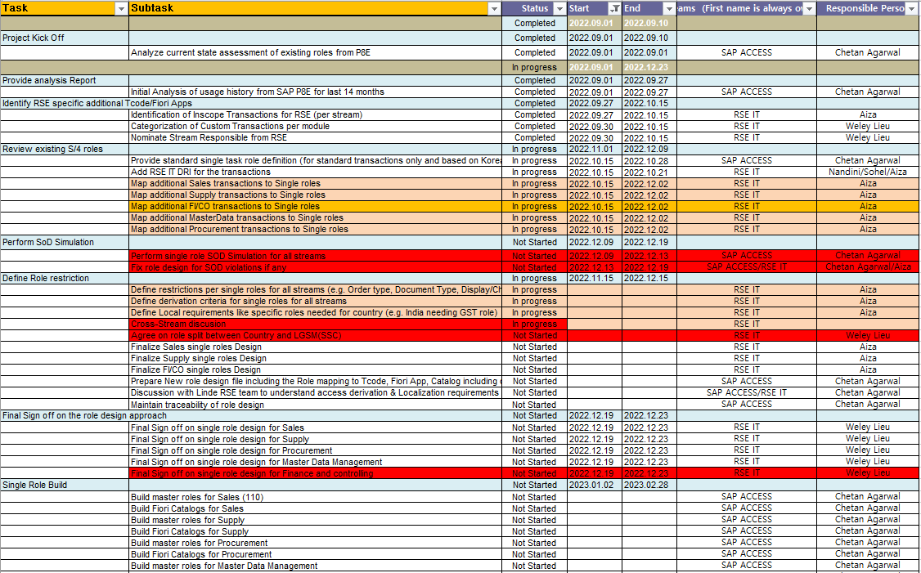
Project S/4 HANA US & Mexico Project Planning Approach
Example
Management Planning:
Tool: PowerPoint
Owner: Project Manager
Usage: Steerco meetings, Business and IT Management Jour Fixes
Project Planning:
Tools: PowerPoint
Owner: Project Manager
Usage: Project Management, Stream meetings and Management Jour Fixes
Example
Example
Stream Planning:
Tool: PowerPoint, Excel
Owner: Stream Lead
Usage: Stream and Project Management meetings
Example

Slide 49
Project S/4 HANA US & Mexico Planning Overview
Stream | Topics | Support | Planning Lead
Project Management | Planning Approach & Tools Project Milestones and planning timeline | Tbd | Derek Punaro Rodolfo Ortiz Chavarin
Infrastructure | Project System planning (SDT) Operations System planning (Dev, QA, Prod) | Tbd | Pravin Shetty
Reporting | Reporting work packages (analysis, build, test) | n/a | n/a
Add-On (e.g., EPP) | Work packages (Retrofit etc.) | n/a | n/a
Satellite (Local/Global) | UAT, Cut Over, Go Live and Hypercare | Tbd | Leonard Eynon
IDM (Authorization) | Single Role build & unit testing Job/Composite design Job/Composite build & unit testing | Tbd | Gellert Kovacs
Development | Design, build, testing fixes etc. | Tbd | Pankaj Agarwal
Functional | Design, build, testing etc. | Tbd | Tbd
Selective Data Transformation | SDT Workshops, SDT milestones, SDT design, build | Tbd | Tobias Hust
Testing | Test Phases, preparation (test cases, data, monitoring, tracking etc.) | Tbd | Pallavi Banerjee
UC4 Jobs | Conversions, Preparations, Testing | T-Systems | Peter Kerschl
Change Management | Training material creation, Train-the-Trainer trainings, EU trainings | Tbd | Derek Punaro/ Martin Vega
Cutover/Release | Cut Over planning, Cut Over plan etc. | Tbd | Armin Pfeiffer
Hypercare | Planning, Approach, etc. | Tbd | Tbd

Slide 50
Project S/4 HANA US & Mexico Lessons Learned
Draft
Area | Topic
Migration | Do not defer critical defects to later Technical Migration Cycles Go Live Simulation: To be executed as close as possible to Cut Over Weekend
Testing | Apply Automated Test Cases during each test cycle Use central test tool qTest for test cases, tracking and defects handling Test all satellites systems and identify responsible Mirror future system set-up at least once (e.g. application server) Ensure high involvement of business testers during User Acceptance Test Ensure high quality of test execution Clearly define what's must to be achieved before UAT, share with FICO Head and secure management support
Cut Over | Communicate and understand Cut Over Plan High discipline on the Cut Over Weekend Manage on-time business stop on agreed time
Project Management | Close coorporation between Corporate IT, regional teams and businesses Initial investigation was done by the region, properly with business by understanding the process and see what has changed now in S/4 and then with proper homework and nature of the issue the Corporate teams were contacted PM should not just focus on timeline, and also be concerned quality, so need to consider both Top management support to push the message that delivery of the project is mandatory
Roles | Intense testing of composite Roles during SIT & UAT End User Simulation: UAT 100% access was done of Business users (Management/PM push ) Freezing point: 3 weeks before cutover, so no new authorization requests came in late - end result was that SOD was clean, only 1 out of 1100 failed

Slide 51
Agenda – Day 3 Wednesday March 12th
Time | Topic | Details | Presenter
08.00h -09.00h | Roles Approach | Single Role, Composite Role, Sign Off, End User Simulation, … | Gellert Kovacs
09.00h – 10.00h | Organizational Change Management | Train-the-Trainer, Tester Training, End User Training, Communication, Newsletter, … | Sneha Dutta, Derek Punaro, Rodolfo Ortiz Chavarin
10:00h – 11:00h | Communication | US Stakeholders, Mexico Stakeholders, Project Meeting Structure, … | Sneha Dutta, Derek Punaro, Rodolfo Ortiz Chavarin
11.00h – 12.00h | Risk Assessment | Identification of project risks | All
12.00h – 13.00h | Lunch
13.00h – 14.00h | Wrap-Up | Document action items & Workshop Closure | Sneha Dutta, Derek Punaro, Rodolfo Ortiz Chavarin
14.00h – 15.00h
15.00h – 16.00h
16:00h – 17.00h

Slide 52
Agenda – Day 3 Wednesday March 12th
Time | Topic | Details | Presenter
08.00h -09.00h | Roles Approach | Single Role, Composite Role, Sign Off, End User Simulation, … | Gellert Kovacs
09.00h – 10.00h | Organizational Change Management | Train-the-Trainer, Tester Training, End User Training, Communication, Newsletter, … | Sneha Dutta, Derek Punaro, Rodolfo Ortiz Chavarin
10:00h – 11:00h | Communication | US Stakeholders, Mexico Stakeholders, Project Meeting Structure, … | Sneha Dutta, Derek Punaro, Rodolfo Ortiz Chavarin
11.00h – 12.00h | Risk Assessment | Identification of project risks | All
12.00h – 13.00h | Lunch
13.00h – 14.00h | Wrap-Up | Document action items & Workshop Closure | Sneha Dutta, Derek Punaro, Rodolfo Ortiz Chavarin
14.00h – 15.00h
15.00h – 16.00h
16:00h – 17.00h

Slide 53
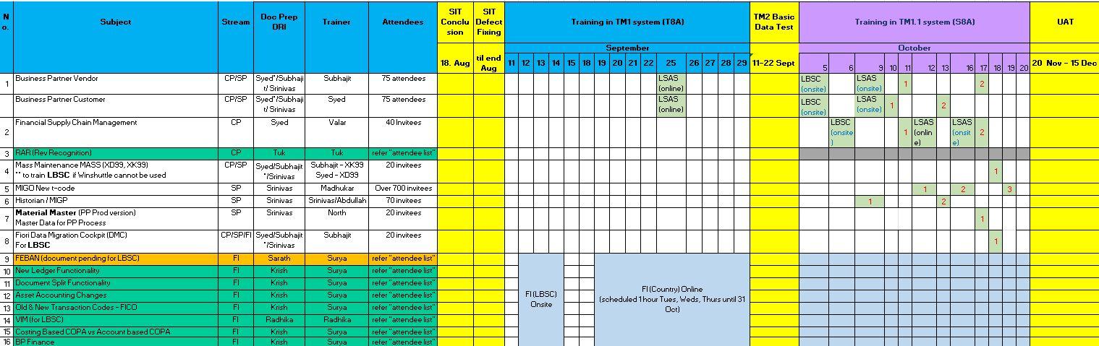
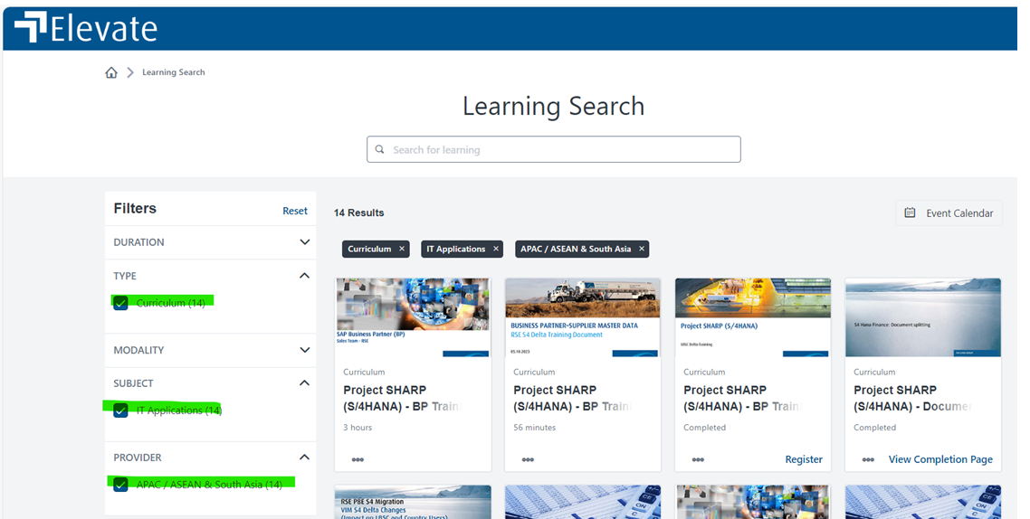
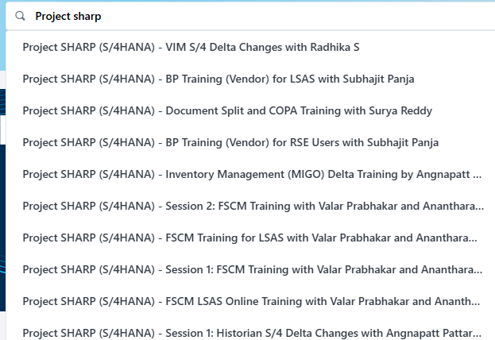
Organizational Change Management (OCM) Overview Key to Success in SAP ECC to S4 Upgrade Project
Example RSE

Slide 54
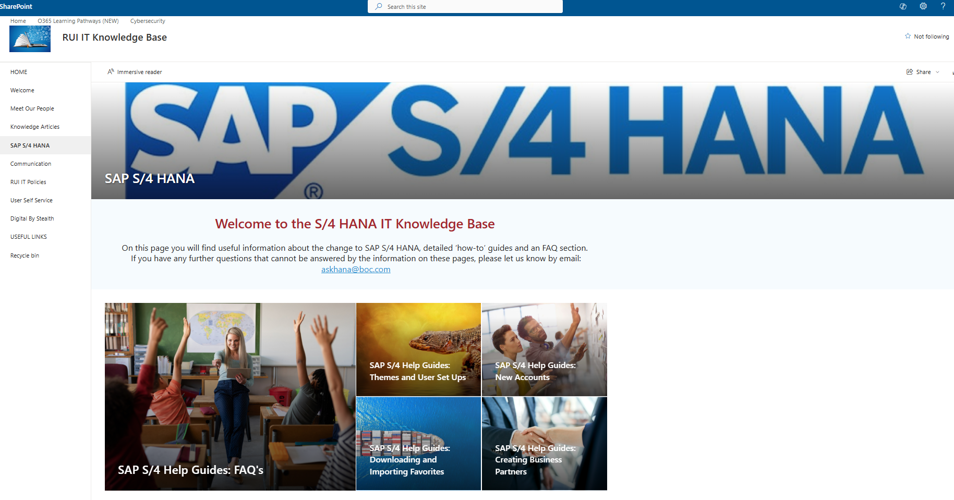
Organizational Change Management (OCM) Overview Key to Success in SAP ECC to S4 Upgrade Project
Example RUI
SAP S/4 HANA

Slide 55
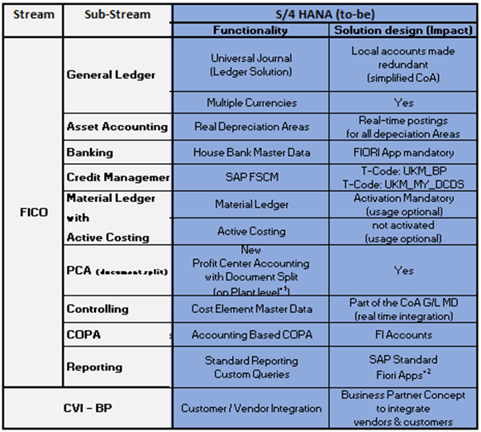
Organizational Change Management (OCM) Overview Key to Success in SAP ECC to S4 Upgrade Project
Example RGC
Change Management Process
OCM Key Activities & Milestones | Start Date | Plan Date | Status
Change Management –Approach/Planning
OCM Detailed planning | 2/26/24 | 4/30/24 | Closed
Approach | 4/1/24 | 4/30/24 | Closed
Stakeholder Engagement | 3/1/24 | 2/28/25 | WIP
OCM Communications | 3/1/24 | 2/18/25 | WIP
Change Impact Analysis/IMP & Monitoring
Change Impact Analysis | 5/6/24 | 7/19/24 | Closed
Change Action Planning | 7/22/24 | 7/31/24 | Closed
Change Action IMP & Monitoring | 8/1/24 | 9/27/24 | Closed
Key/End User Training | 8/12/24 | 11/13/24 | WIP
Key User Training Material update | 8/12/24 | 9/30/24 | Closed
Training Planning | 9/2/24 | 9/27/24 | Closed
Key User and 1st Round End User Training | 10/8/24 | 10/18/24 | WIP
Sales | 10/8/24 | 10/25/24 | WIP
Supply | 10/8/24 | 10/25/24 | WIP
FICO | 10/14/24 | 11/13/24 | WIP
2nd round End User reinforce training
Sales | 2/6/25 | 2/10/25 | Planned
Supply | 2/6/25 | 2/10/25 | Planned
FICO | 2/10/25 | 2/12/25 | Planned
User Manual Prep | 10/28/24 | 12/31/24 | Planned
Transition & Cut over | 12/20/24 | 2/16/25 | Planned
Go-Live | 2/16/25 | 2/17/25 | Planned
OCM
Lunch & Setup
Communications
Change
Readiness
1
3
5
Stakeholder
Engagement
Change Impact
Analysis/IMP
& Monitoring
End User
Training
2
4
6
Key Changes - (continue working on impact analysis)

Slide 56
Agenda – Day 3 Wednesday March 12th
Time | Topic | Details | Presenter
08.00h -09.00h | Roles Approach | Single Role, Composite Role, Sign Off, End User Simulation, … | Gellert Kovacs
09.00h – 10.00h | Organizational Change Management | Train-the-Trainer, Tester Training, End User Training, Communication, Newsletter, … | Sneha Dutta, Derek Punaro, Rodolfo Ortiz Chavarin
10:00h – 11:00h | Communication | US Stakeholders, Mexico Stakeholders, Project Meeting Structure, … | Sneha Dutta, Derek Punaro, Rodolfo Ortiz Chavarin
11.00h – 12.00h | Risk Assessment | Identification of project risks | All
12.00h – 13.00h | Lunch
13.00h – 14.00h | Wrap-Up | Document action items & Workshop Closure | Sneha Dutta, Derek Punaro, Rodolfo Ortiz Chavarin
14.00h – 15.00h
15.00h – 16.00h
16:00h – 17.00h

Slide 57
Project S/4 HANA US & Mexico Project Meeting Structure
Draft
Forum | Objectives | Frequency | Owner | Regular Participants
SAP Authorization Stream Meeting | Monitor progress vs plan for time critical activities Focus on issues, risks & escalate as appropriate | Weekly | Gellert Kovacs | Corporate IT and Regional IT Roles team members
Testing Stream Meeting | Monitor progress vs plan for time critical activities Focus on issues, risks & escalate as appropriate | Weekly | Pallavi Banerjee | Corporate IT and Regional IT Testing team members
Regional Change Management Meeting | Update on project progress Close involvement and get expectation | Weekly | Tbd | Regional US & Mexico business coordinators
Archiving/ Tributus | Monitor progress vs plan for time critical activities Focus on issues, risks & escalate as appropriate | Weekly | Tbd | Corporate IT and Regional IT Archiving team members
Reporting | Covers local Reporting , BW Reporting and Informatica Monitor progress vs plan for time critical activities Focus on issues, risks & escalate as appropriate | Weekly | Tbd | Corporate IT and Regional IT Reporting team members
SDT Meetings | Monitor progress vs plan for time critical activities Focus on issues, risks & escalate as appropriate | Daily | Tobias Hust | Corporate IT and Regional IT SDT team members

Slide 58
Project S/4 HANA US & Mexico Project Meeting Structure
Forum | Objectives | Frequency | Owner | Participants
S/4 HANA Program Steerco | Approve plans & scope changes Resolve issues Agree recommendations/decisions/actions needed from steerco Related to S/4 HANA program topics | Monthly | Stephan Domes | Denny Brown, Michael Kurtz, Danny Perri, Leon Xu, Dulce Borjas, Goran Cederwall, Katharina Conrad, Natarajan Thiyagarajan, respective regional IT Heads/ PMs
S/4 HANA Americas Jour Fix | As above related to Americas project topics | Monthly | D. Punaro Y. Mellado | Dulce Borjas, Pete Casazza, Adrian Espinosa, Michael Kurtz, Goran Cederwall, Katharina Conrad, Natarajan Thiyagarajan
Mexico Business SteerCo | As above related to Mexico project topics | Bi-monthly | A. Espinosa | Country/Cluster Head/CFO
US Business SteerCo | As above related to US project topics | Bi-monthly | P. Casazza | Mark Alexion, Bill Heintz, John J. Byrne, Adam G. Schmidt, Derek Punaro, Stuart Boyd
US & Mexico PM Jour Fix | Monitor progress vs plan for time critical activities Focus on issues, risks & escalate as appropriate | Weekly | D. Punaro Y. Mellado | Stuart Boyd, Natarajan Thiyagarajan, Stephan Domes, …
US & Mexico Integration Stream Meeting | Monitor progress vs plan for time critical activities Focus on issues, risks & escalate as appropriate | Bi-Weekly | Stuart Boyd | Project stream leads (Corporate IT & Regional IT)
US & Mexico Overall Project Meeting | Update regarding overall project progress | On demand | Sneha Dutta | Overall US & Mexico project team

Slide 59
Agenda – Day 3 Wednesday March 12th
Time | Topic | Details | Presenter
08.00h -09.00h | Roles Approach | Single Role, Composite Role, Sign Off, End User Simulation, … | Gellert Kovacs
09.00h – 10.00h | Organizational Change Management | Train-the-Trainer, Tester Training, End User Training, Communication, Newsletter, … | Sneha Dutta, Derek Punaro, Rodolfo Ortiz Chavarin
10:00h – 11:00h | Communication | US Stakeholders, Mexico Stakeholders, Project Meeting Structure, … | Sneha Dutta, Derek Punaro, Rodolfo Ortiz Chavarin
11.00h – 12.00h | Risk Assessment | Identification of project risks | All
12.00h – 13.00h | Lunch
13.00h – 14.00h | Wrap-Up | Document action items & Workshop Closure | Sneha Dutta, Derek Punaro, Rodolfo Ortiz Chavarin
14.00h – 15.00h
15.00h – 16.00h
16:00h – 17.00h

Slide 60
Project S/4 HANA US & Mexico Key Project Risks
Draft
Risk | Description & Impact | Mitigation
Project Role Definition | Unclear role definition can lead to delays and confusion | Clear definition of Director IT role Clear definition of Project Manager Clear definition between USA and Mexico
SAP Expertise | Limited regional SAP expertise compared to other regions | Ramp up of external SAP resources and expertise Involve business experts as soon as possible Balance SAP expertise on several persons across several tasks as soon as possible (e.g. testing, training, MCR)
One Project | Two different businesses are running on the same SAP system Risk of going on different speed and milestones can only be considered as completed in case both businesses have completed it | Close alignment between all project managers Clear definition of milestones and sign off Define always two persons for sign off (Mexico & USA)
Time Zone | Project is running over many different time zones from business side (US East to West Coast) Corporate IT Delivery Center in Kolkata provides key services for project (e.g. SAP Roles, SAP Basis) | Detailed travel planning Schedule project meetings in best available time window (e.g. SDT Daily, PM JF, Cut Over meetings) Detailed Dress Rehearsal and Cut Over Planning Leverage more Europe based Corporate IT experts

Slide 61
S/4 HANA Transformation
Thank you for your attention

Slide 62
S/4 HANA Landscape Transformation Below 3 type of Changes in S/4 HANA impacting Authorization Concept
Primarily 3 major changes are driving the Authorization concept changes in S/4 HANA including Fiori Apps
Change | Example
“New” transactions for existing processes (with S/4 additional functionality also got introduced) | Create Customer S/4 HANA : BP ERP (R3) : XD01/FK01 Goods Received S/4 HANA : MIGO ERP (R3) : MB01, MB11
Fiori Apps introduces both Mandatory and Optional functionalities; in some cases, even replacing existing transactions (Korea S/4 : 150 Fiori Apps has been enabled in addition to ~800 classical transactions, mandatory 7-8 Fiori Apps needs to be enabled/authorized) | Bank Master (Mandatory) S/4 HANA : Manage Banks/ House Banks (Fiori) ERP (R3) : FI01 Additionally, optional Fiori Apps are available for many SAP transactions which can be enabled only with Authorization approach
Authorization checks have been changed in SAP transactions | Transaction QA01 is checking for new Activity “F4” and additional objects e.g. “inspection lot and types”
Slide 23
Slide 24
Slide 25

Slide 63
Detailed Project Approach for Authorizations (1/2) Optimized role concept using composite job role; leveraging RSE design
BPS
Design new roles with Business
50-60 man days from reg IT
17-20 days for Business
Business
Optimized role concept
Business
Single Role Design
Composite Role Design
Build Roles
Test
Rollout/Golive
BPS
Leverage RSE design for Single role and Composite roles
Reduced Test approach can be used for optimized role concept limiting overall testing efforts.
RGC can benefit from already tested roles from past projects (RSE)
Number of roles to be tested reduces significantly
Meaningful test based on job roles possible
Linde specific enablers
Usage History (in order to support identification of user/role mapping)
SoD mitigation history
80% less roles with clear responsibility ➔ decreases efforts for changes, assignments and reviews
Limiting the risk of SOX finding
Consequences: Non-optimized auth concept
New role design is utilizing Project Set-Up with Test phases, approach and resources
High number of roles and assignments (difficult management, review; ownership with IT)
Risk of SOX findings stays (SOD, least privilege, role ownership)
Clean up in Future needs to be managed locally

Slide 64
Detailed Project Approach for Authorizations (2/2) Details of Single & Composite Role design phases
Single Role Design/Build
Leverage RSE Design (RSE already designed & tested the single roles)
Composite Role Design
Identify Departments for jobs roles & their Leads (e.g., CSC, G&G)
Finalize Authorization Concept
Build Composite role
Design & Build Sign off
Delta Single role build
RGC derived role build
Unit test RGC specific build
Identify Reference users
Analyze usage History of Ref users
Confirm transactions based on usage analysis
Final discussions on transactions
Composite Role Design Sign off
SOD check and delta build
Functional Authorization Tests for Composite roles
Mandatory S4 updates: Obsolete Tcode replacement e.g. BP, Bank Master, Mandatory Fiori Enablement
For each department (~25-30):
How to design ?
Single Role Design: Majority of used transactions from RGC is already included in the single role design from RSE or Korea and hence the single role design will be heavily leveraged reducing the effort on RGC single role design.
Composite Role Design: For identification of department, RSE job roles can be used as reference along with the Department information from SAPHRON for existing SAP user base (e.g. Gas & Gear, CSC, CES, Operations, Healthcare, etc)

Slide 65

Design and Conceptual changes in S/4 HANA Updated and Restructured Role Concept
Role assignments – “old”
role concept
Role assignments – “restructured ” role concept
AP Manager
AP Manager
AP Creator
AR Reporting
AP Manager
AP Reporting
KPI Reporting
Finance Display
Invoice Clearing
Single Role
Document Parking
Single Role
Single Role
Invoice Entry
Single Role
No Composite Roles
More than 30 single roles assigned
Many Transactions (~1000) assigned
Only 10% of assigned transactions are used
2-4 composite Roles
5-7 single role per composite role
Roughly 150 Transactions assigned
Transactions included based on usage history
Single role
Composite role

Slide 66
Composite role structuring Example of composite role approach
Sample O2C Process
Technical access (SAP T-Codes) have been mapped to the global O2C role design
Custom Master Creation
Sales Order
Delivery Document
Billing document
Shipping Document
Customer Invoice
Customer Payment
Bank Reconciliation
Business Job Role
T4 – Special access role
Customer Block/
Unblock
Sales Order Mass Change
GI Posting and Accrual Batch Job
Accounting
Entry for PGI
Evaluated Receipt Settlement
T3 – TASK BASE role
Customer Master Creation
Sales Order creation
Delivery Document
Billing Documents
Shipping Document
Customer
Invoice
Customer Payment
Bank Reconciliation
T2 – Display role
O2C Display Role
T1 – Basic role
Universal Display Role

Slide 67
S/4 HANA Transformation
Selective Data Transformation

Slide 68
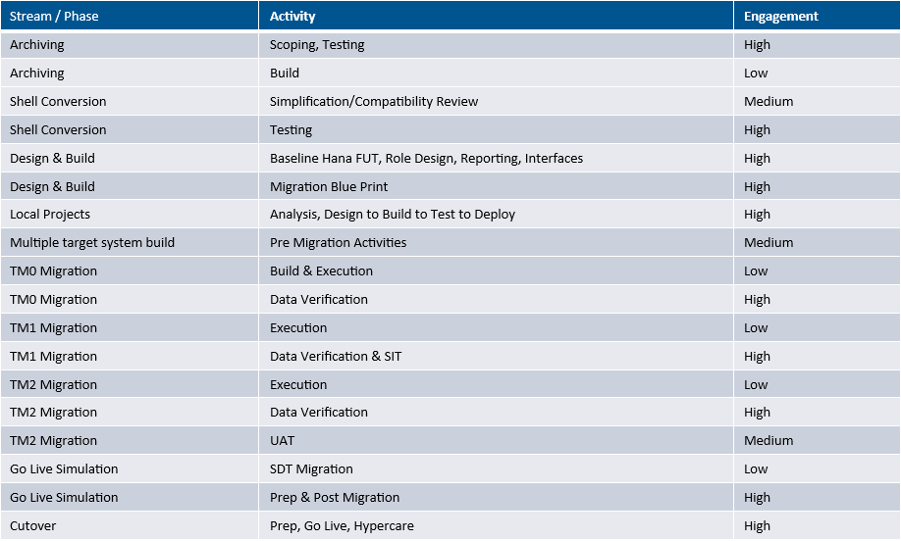
S/4 HANA Landscape Transformation Workload

Slide 69

SDT Illustration of MBP approach Migration Business Blueprint (MBP) development
2023
Jan
Feb
Mar
Apr
May
June
July
August
Analyze & Design
Develop
Testing
Project
Create SDT MBP
Refine SDT MBP
#1 FIN 16.01.23
MBP Boundaries defined (NGL,…)
#1 Non-FIN 17.01.23
#2 FIN 2 30.01.23
Mapping structures defined
System Integration / Functional Test
#2 Non-FIN 31.01.23
#3 FIN 06.02.23
Standard Mappings defined
Functional test feedback on data errors (SIT)
#3 Non-FIN 07.02.23
#1 BP 16.02.23
Business Partner
#1 Custom
20.02.23
Custom Table Mappings defined
SDT
MBP finalized End of July
MBP Released Thu 23.02.23
MBP 28.02.23 Signed off
Living MBP Document
Initial SNP tools configuration from MBP
Fixes driven from data verification errors (TMx)
Expert system analysis
Table Difference analysis ECC vs S4 for Custom / Add On Tables
SNP Tools Platform
Mappings, Config
Errors
Mappings, Config fixes
Errors
TM0 Activities
TM1 Activities
Data Verification signoff
TM2 Activities
Data Verification Report extensions
Data Verification signoff
Infra
P8E TC Cockpit access
SRC1 and TMO Boxes provisioned 14.02.23
P8E System Scan
Linde
ACN/SNP

Slide 70


The SDT “Technical Migration” Approach (1/2) Technical Data Migration Assurance on DB Level
BACKUP
1. Technical Data Migration (logs)
Export data from source / import into target
Number of records exported against imported must tally at the table level
ALL standard/custom tables in scope are included
1:1 tables including custom tables – any divergence on the record count between systems will be reported as failure
2. Data Consistency Verification (DCV)
Fixed value tables must correspond, Foreign-key to header check
Inconsistencies in source / target tracked workflow managed towards resolution
System DCV reports & logs
Control System
Logs Delta
DCV
Selection Rules
Mapping Rules
ABAP Export
Progs.
ABAP Import
Progs.
Logs
File Share
Logs
Oracle ECC DB
HANA S4 DB
Technical assurance that data is transferred within database schema constraints, including 1:1 record counts for all /custom tables

Slide 71
The SDT “Technical Migration” Approach (2/2) Functional Data Migration on Application Level
BACKUP
3. Automated Testing (AT)
Automated functional and regression test in SAP Systems
Identification of inconsistences in SAP data and customizing
Ready-to-use SNP test objects for SAP ERP – option for custom-specific adaptation
Tests on SAP application level - independent from the user interface
Automatic and flexible selection of test data for each test object
4. Migration Cockpit Reconciliation reports (MC)
Reports on source and target executed and compared – must equal on both systems – option for custom-specific addition (e.g. customer holdings)
MC Delta Reports
AT Reports
Control System
delta
MC
MC
AT
Reports in MC scope
ABAP / TX
Reports in MC scope
Oracle ECC DB
HANA S4 DB
Functional testing assures that transformed standard objects (ECC to S4) are tested on application level in change mode, invoking SAP validation

